Slide 1
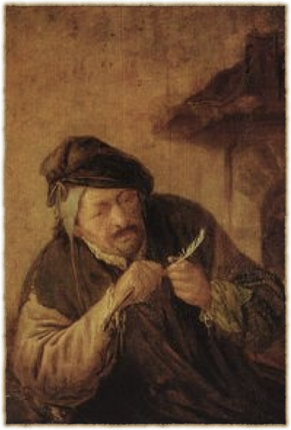
Living as a Person of the Gospel as Teacher and Writer
My Vocations

Slide 2
As a teacher. . .
Who is my neighbor whom I am to love and serve?

Slide 3
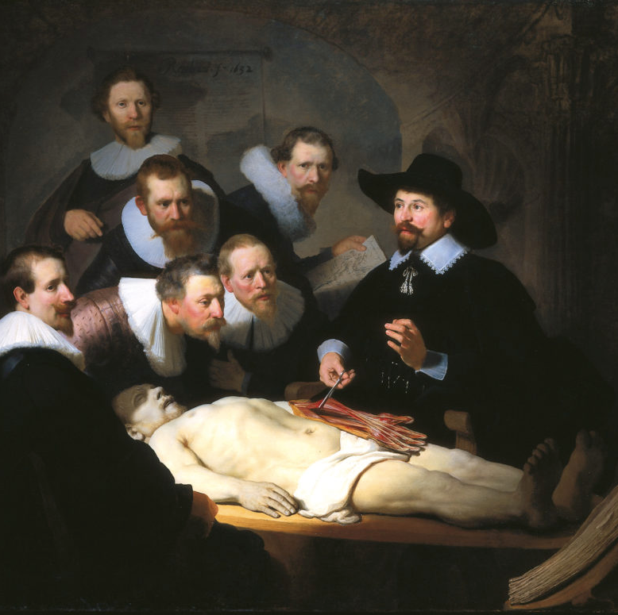
My students
teach them what they need to know
make the subject as interesting as possible
relate to them as human beings

Slide 4
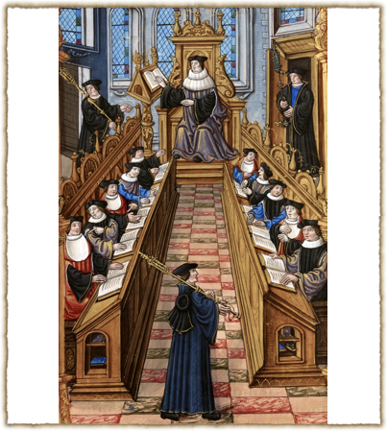
My colleagues
“collegiality”
academic politics
good of the institution
good of the profession

Slide 5
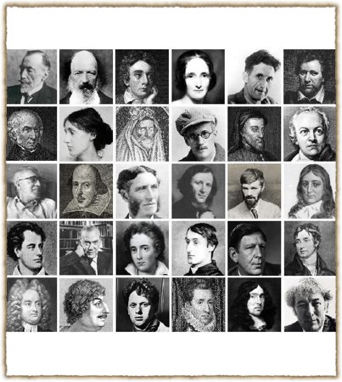
My subjects
Help them communicate with my students
Help my students understand them
Help my students appreciate them

Slide 6
Temptations & Sins of Teaching
Retreating into my own interests
Looking down on my students
Not giving them my best
Procrastination in grading & preparation

Slide 7
Crosses & trials of teaching
Students that I can’t reach
Non-responsive or hostile students
Institutional frustrations
Burnout

Slide 8
Moments of Praise in Teaching
When the light comes on in their eyes
When I read good work from my students
When the student surpasses the teacher
When I meet former students who now have vocations for which I have prepared them

Slide 9
As a writer. . .
Who is my neighbor whom I am to love and serve?

Slide 10
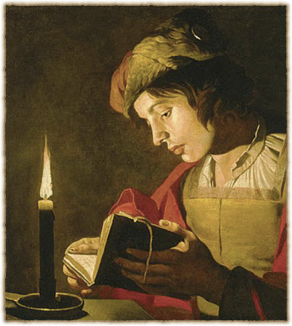
My readers
Don’t corrupt or mislead them
Be clear
Give them something valuable
Try to delight as well as teach

Slide 11
Temptations and sins of writing
pandering
rhetorical manipulation of readers
difficult style for simple content
dishonesty & distortion
the Bohemian fallacy
being a prima donna

Slide 12
Crosses & trials of writing
getting published
getting reviewed
getting attacked
doing the writing

Slide 13
Moments of praise in writing
being “in the zone”
finishing a project
hearing from a reader who connected with the book
hearing from a reader who was influenced by the book

Slide 14
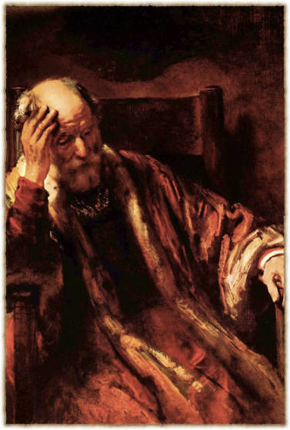
My new vocation
Retirement

Slide 15
Being able to attend more to my vocations in the other estates
the family
the church
the community
the common order of Christian love

Slide 16
