Slide 1
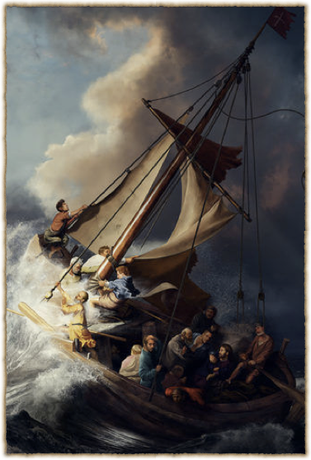
Vocation and the Christian Life

Slide 2
The vocation of Christians and the offices of non-believers
God providentially works through both
Working in unbelief
    for the self
    work and relationships are empty of God
Working in faith
    for the neighbor
    work and relationships give glimpses of the hidden God

Slide 3
We live out our Christian faith primarily in our vocations
The fruits of faith
    “faith working through love” (Galatians 5:6)
Where evangelism happens
Where sanctification happens

Slide 4
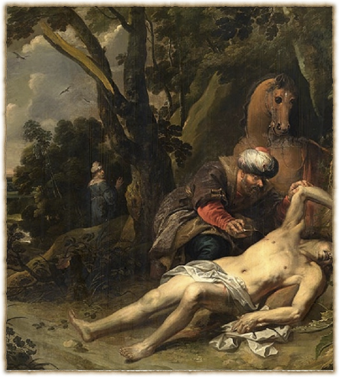
Good works in Vocation
When we love and serve the neighbors of our vocations, we are “co-workers with God” (1 Corinthians 3:9).
His love expressed through our love
His creation & our creativity
Notes:
Balthasar van Cortbemde (1612–1663)

Slide 5
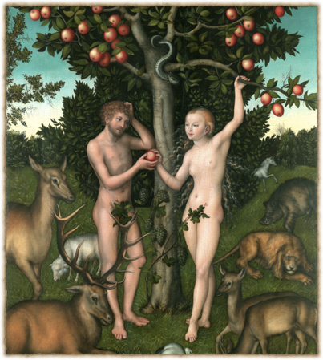
Sin in Vocation
harming your neighbor
sinning against vocation
acting outside of vocation
wanting to be served rather than to serve

Slide 6
Bearing the Cross in Vocation
“And he said to all, “If anyone would come after me, let him deny himself and take up his cross daily and follow me. For whoever would save his life [ψυχὴν]will lose it, but whoever loses his life [ψυχὴν] for my sake will save it.” (Luke 9:23-24)

Slide 7
The Cross as an instrument of sacrifice
Loving & serving the neighbor = sacrificing one’s self for one’s neighbor
“present your bodies as a living sacrifice” (Romans 12:1)
But remember Christ’s promise:
    “For whoever would save his life [ψυχὴν]will lose it, but whoever loses his life [ψυχὴν] for my sake will save it.”

Slide 8
Self-denial vs. Self-fulfillment
Vocation is NOT about self-fulfillment
    some ARE fulfilling; some are not
    misconceptions about vocation
    the neighbor, not self
    our growth, not our desires

Slide 9
The Vocation of Marriage
22 Wives, submit to your own husbands, as to the Lord. 23 For the husband is the head of the wife even as Christ is the head of the church, his body, and is himself its Savior. 24 Now as the church submits to Christ, so also wives should submit in everything to their husbands. (Eph 5)
25 Husbands, love your wives, as Christ loved the church and gave himself up for her, 26 that he might sanctify her, having cleansed her by the washing of water with the word, 27 so that he might present the church to himself in splendor. (Eph 5)
21 submitting to one another out of reverence for Christ. (Eph 5)

Slide 10
More vocations from Ephesians 6
6 Children, obey your parents in the Lord, for this is right. 2 “Honor your father and mother” (this is the first commandment with a promise), 3 “that it may go well with you and that you may live long in the land.” 4 Fathers, do not provoke your children to anger, but bring them up in the discipline and instruction of the Lord.
5 Bondservants,[a] obey your earthly masters with fear and trembling, with a sincere heart, as you would Christ, 6 not by the way of eye-service, as people-pleasers, but as bondservants of Christ, doing the will of God from the heart, 7 rendering service with a good will as to the Lord and not to man, 8 knowing that whatever good anyone does, this he will receive back from the Lord, whether he is a bondservant or is free. 9 Masters, do the same to them, and stop your threatening, knowing that he who is both their Master and yours is in heaven, and that there is no partiality with him.

Slide 11
Authority in Vocation
And Jesus called them to him and said to them, “You know that those who are considered rulers of the Gentiles lord it over them, and their great ones exercise authority over them. But it shall not be so among you. But whoever would be great among you must be your servant, and whoever would be first among you must be slave of all. For even the Son of Man came not to be served but to serve, and to give his life as a ransom for many.” (Mark 10: 42-45)

Slide 12
Sanctification in Vocation
Battling sin
Every vocation has its besetting sins
Mortification
    “Put to death” & “Put on Christ” (Col 3:5-17)
Repentance & forgiveness

Slide 13
From the Catechism on Confession: Vocation & Absolution
Consider your place in life according to the Ten Commandments: Are you a father, mother, son, daughter, husband, wife, or worker? Have you been disobedient, unfaithful, or lazy? Have you been hot-tempered, rude, or quarrelsome? Have you hurt someone by your words or deeds? Have you stolen, been negligent, wasted anything, or done any harm?
I believe that when the called ministers of Christ deal with us by His divine command, in particular when they exclude openly unrepentant sinners from the Christian congregation and absolve those who repent of their sins and want to do better, this is just as valid and certain, even in heaven, as if Christ our dear Lord dealt with us Himself.

Slide 14
Enduring trials
    Besetting trials in each vocation
Trials drive us to prayer
Trials drive us to the Word of God
We increase our dependence upon God

Slide 15

The exercise of faith growth in faith
The pattern of the Christian life:
      Worship Vocation

Slide 16
Doctrine of Vocation = the Priesthood of all believers
This does NOT mean that all believers are pastors.
Or that we don’t need pastors.
It means that you don’t have to be a pastor to be a priest.

Slide 17
Why Protestant clergy usually aren’t called “priests”
Roman Catholic priests offer up Christ as a sacrifice in the mass
Christ’s sacrifice is “once for all when he offered up himself”(Heb 7:27).
pastors, ministers, preachers
No more sacrifices for sin, but a new kind of sacrifice

Slide 18
What is a priest?
Someone with access to what is holy
An intercessor
Someone who performs sacrifices

Slide 19
Priestly sacrifices in vocation
Loving & serving the neighbor = sacrificing one’s self for one’s neighbor
Bearing the Cross
“present your bodies as a living sacrifice” (Romans 12:1)
Sacrifice of thanksgiving (Psalm 50:23)
Sacrifice of praise (Hebrews 13:15)

Slide 20
“In all our religious and ethical life, we are given to an incredible overestimation of the extraordinary at the expense of the ordinary.”
–Einar Billing, “Our Calling”

Slide 21
Books about the Lutheran Doctrine of Vocation
Althaus, Paul. The Ethics of Martin Luther. Minneapolis, MN: Fortress Press, 2007.
Benne, Robert. Ordinary Saints. Minneapolis, MN: Augsburg Fortress, 2004.
Billing, Einar. Our Calling. Philadelphia: Fortress Press, 1964.
Veith, Gene Edward. God at Work: Your Christian Vocation in All of Life. Crossway Books.
----------, with Mary Moerbe. Family Vocation: God’s Calling in Marriage, Parenting, and Childhood. Wheaton, IL: Crossway Books, 2012.
----------, Working for Our Neighbor: A Lutheran Primer on Work, Economics, and Ordinary Life. Grand Rapids, MI: Christian’s Library Press, 2016.
Wingren, Gustaf. Luther on Vocation. Eugene, OR: Wipf & Stock, 2004.

