Slide 1
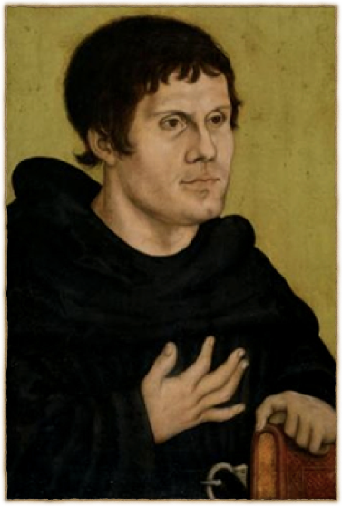
Luther’s Theology of Vocation

Slide 2
Only let each person lead the life that the Lord has assigned to him, and to which God has called him.
(1 Corinthians 7:17)

Slide 3
16 For how do you know, wife, whether you will save your husband? Or how do you know, husband, whether you will save your wife? 17 Only let each person lead the life that the Lord has assigned to him, and to which God has called him. This is my rule in all the churches. 18 Was anyone at the time of his call already circumcised? Let him not seek to remove the marks of circumcision. Was anyone at the time of his call uncircumcised? Let him not seek circumcision. 19 For neither circumcision counts for anything nor uncircumcision, but keeping the commandments of God. 20 Each one should remain in the condition in which he was called. 21 Were you a bondservant when called? Do not be concerned about it. (But if you can gain your freedom, avail yourself of the opportunity.)

Slide 4
God works through human beings

Slide 5
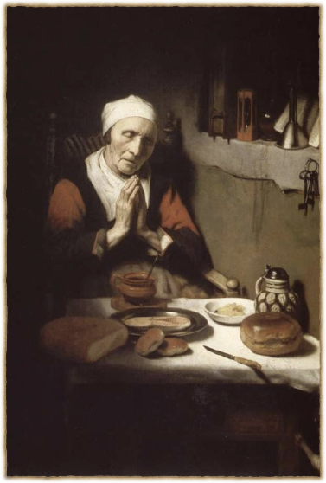
When we ask God to “give us this day our daily bread”. . .
Notes:
Painting by Nicholae Maes, a student of Rembrandt’s

Slide 6
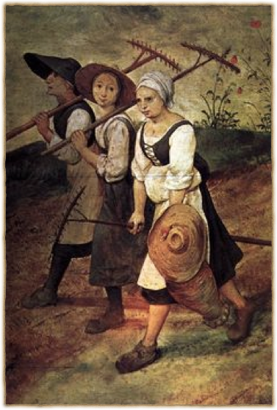
God gives us our bread by means of farmers
Notes:
Peter Bruegel (1555)

Slide 7
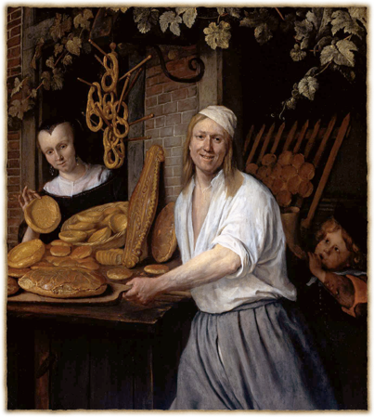
Also. . .
Millers
Bakers
Shopkeepers
Truck drivers
Factory workers
Bankers
and the rest of our economy

Slide 8
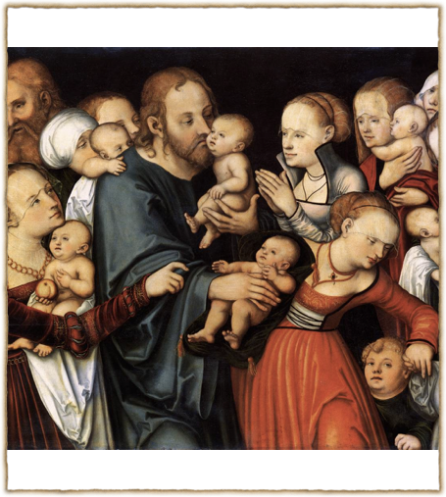
God creates new human beings
by means of mothers and fathers

Slide 9
God. . .
Protects us by means of lawful magistrates (Romans 13)
Heals us by means of physicians, nurses, and other health care vocations
Gives us the blessings of technology by means of scientists and engineers
Creates beauty by means of artists

Slide 10
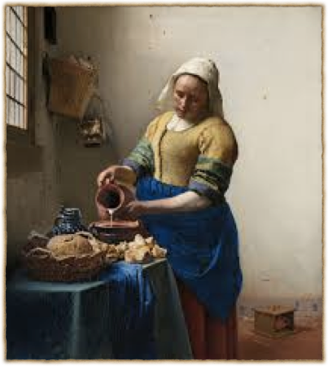
Vocation as a Mask of God
“God is milking the cows through the vocation of the milkmaid.” Luther
God is hidden in vocation
    present, but not seen
Notes:
Vermeer, “The Milkmaid”

Slide 11
God blesses you through others
And God blesses others through you

Slide 12
Our multiple callings in the estates for human life

Slide 13
The Estate of the Home

Slide 14
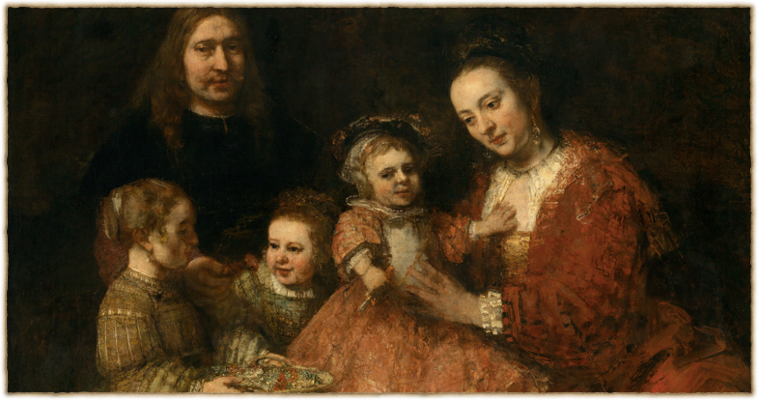
The Vocations of the Family
marriage, parenthood, childhood

Slide 15
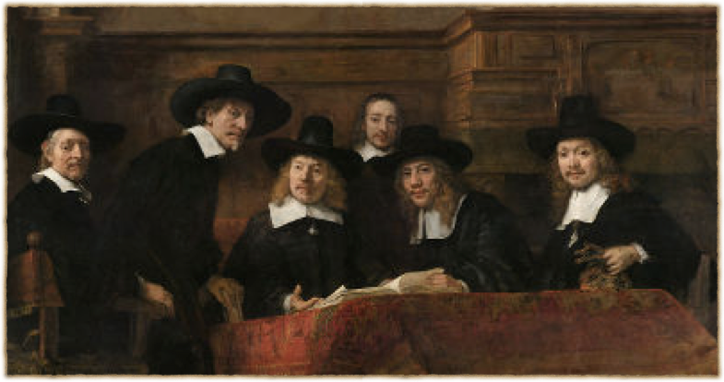
The economic vocations
οἰκονομία = οίκος (home)+ νομία (laws)
Notes:
Rembrandt, “The Syndics of the Draper’s Guild” (cloth inspectors)

Slide 16
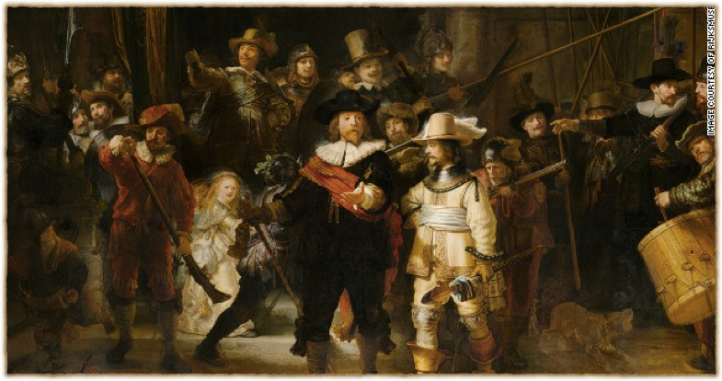
The Estate of the State
The vocations of government & citizenship

Slide 17
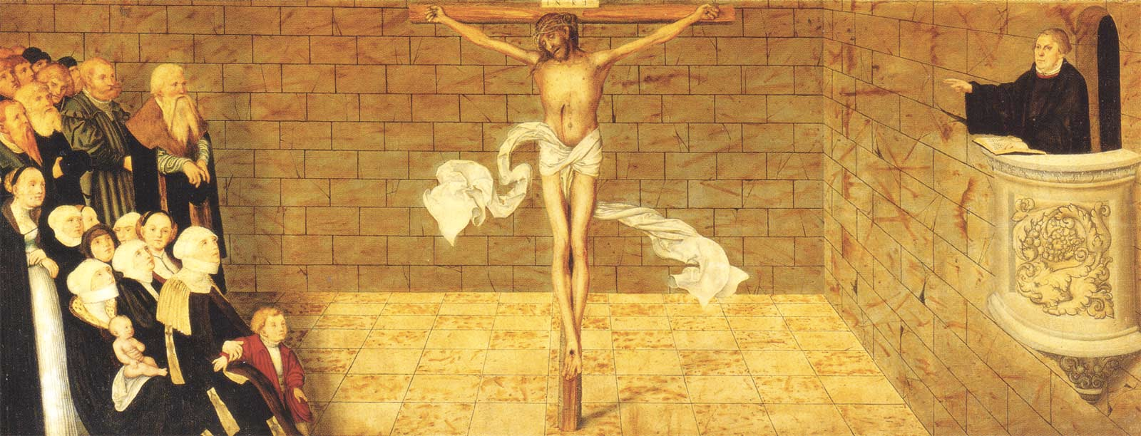
The Estate of the Church
The Calling of the Gospel, the call of the pastor, the vocations within the congregation

Slide 18
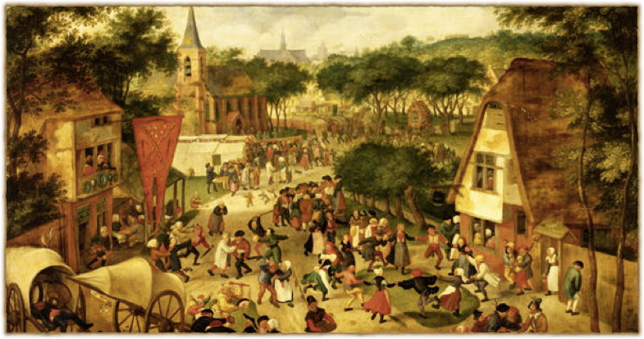
The common order of Christian love
informal relationships & interactions, good Samaritan, occasions for service, friendships
Notes:
Jacob Savery, 1566-1603. Dutch Anabaptist.

Slide 19
Medieval view of vocation
Vocation = a call to join a religious order
    the church orders (“perfection”) vs. the laity (Ten Commandments)
    vows:
        celibacy (vs. marriage & parenthood)
        poverty (vs. economic labor)
        obedience (vs. citizenship in the state)

Slide 20
Reformation view of vocation
The vows repudiated God’s design for human life
marriage, parenting, economic labor, citizenship are themselves “holy orders” no less than church work
Table of Duties: “Certain passages of Scripture for various holy orders and positions, admonishing them about their duties and responsibilities”: Husbands, wives, children, citizens, “workers of all kinds,” etc.

Slide 21
The purpose of every vocation:
To love and serve your neighbors

Slide 22
“God does not need our good works. . .
But our neighbor does”

Slide 23
Loving God & Loving our Neighbor
“You shall love the Lord your God with all your heart and with all your soul and with all your strength and with all your mind, and your neighbor as yourself.” (Luke 10:27)
“In this is love, not that we have loved God but that he loved us and sent his Son to be the propitiation for our sins.” (John 4:10)
Faith: Relationship to God is based on Christ alone.
Works: Then God sends us to do good works for our neighbors.
Christ hidden in our neighbor (“As as you did it to one of the least of these my brothers, you did it to me.’” [Matthew 25:40])

Slide 24
“Who is my neighbor?” (Luke 10:29):
Whom am I to love and serve in my vocations?
in marriage?
in parenthood?
in childhood?
in the workplace?
in our citizenship?
in the church?
in the common order of Christian love?

Slide 25
God’s design for human flourishing
Everyone loving and serving each other
Everyone giving and receiving
The division of labor: self interest vs. love of neighbor
Society as a vast, complex network of love
BUT SIN. . .

