Slide 1

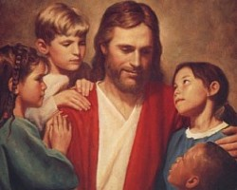
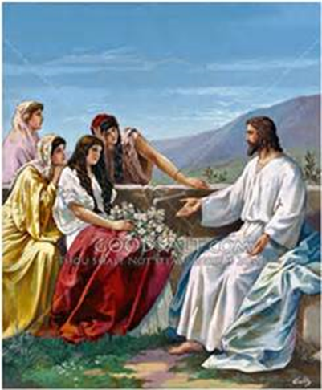
Speak Lord Conference
“Law and Gospel in Biblical Peacemaking”

Slide 2
Biblical
Catechetical
Practical
“Law and Gospel in Biblical Peacemaking”

Slide 3
Three Foci
What does Law and Gospel look like in my life personally?
How is the Law and the Gospel a blessing in my relationships?
What does Law and Gospel look like in our life together?
Confession and forgiveness
embedded as “a way of life”
“The life of the baptised!”

Slide 4
“The Lord’s Prayer!”
And…the little word ‘and’

Slide 5
“The Lord’s Prayer!”
“Give us today our daily bread”
What is this?
God certainly gives daily bread to everyone without our prayers, even to all evil people, but we pray in this petition that God would lead us to realise this and to receive our daily bread with thanksgiving.

Slide 6
And forgive us our trespasses as we forgive those who trespass against us.’
What is this?
We pray in this petition that our Father in heaven would not look at our sins, or deny our prayer because of them. We are neither worthy of the things for which we pray, nor have we deserved them, but we ask that He would give them all to us by grace, for we sin daily much and surely deserve nothing but punishment. So we too will sincerely forgive and gladly do good to those who sin against us.

Slide 7
“Life of the baptised”
“Our whole life is to be one of daily repentance”
Our life is a life of Confession and forgiveness

Slide 8
“Life of the baptised”
Romans 6:1-14
The message of the Baptism candle

Slide 10
“for the sake of the Gospel”
The Holy Spirit works with the Law
so that we can see our sin,
acknowledge and confess it
in order to hear the Gospel!
God heals
with the Word of the Gospel

Slide 11
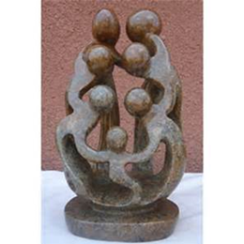
“for the sake of the Gospel”
Applying the Law so that the Holy Spirit can lead the person to identify,
acknowledge and confess their sin;
And for us to proclaim the Gospel!

Slide 12
Psalm 51:6
“Behold, you delight in truth in the inward being, and you teach wisdom in the secret heart”
“Biblical Peacemaking
is Heart Work”

Slide 13
Psalm 51:10
“Create in me a clean heart, O God, and renew a right spirit within me”
“Biblical Peacemaking
is Heart Work”

Slide 14
“Can you help me understand..”
Use Questions

Slide 15
“Biblical Peacemaking is the Holy Spirit’s work…”
Being “Face to Face with Jesus”
Bringing others ‘Face to Face with Jesus
“Would you be interested to see what God’s Word might say about that?”

Slide 16
Questions that serve the heart
I’m hearing guilt, is that true?
I’m hearing shame, is that what you are feeling?
Touching the brokenness
to bring healing!

Slide 17
“Life in the body of Christ!”
David – Psalm 51
“Create in me a clean heart…
…and I will teach transgressors your ways,
and sinners will return to you!”

Slide 18
Marriage!

Slide 19
Parenting!

Slide 20
Baptised Life in the church!
Ephesians 4:31, 32
Let all bitterness, and wrath, and anger, and clamour, and evil speaking, be put away from you, with all malice: and be ye kind one to another, tender-hearted, forgiving one another, even as God for Christ’s sake has forgiven you.

Slide 21
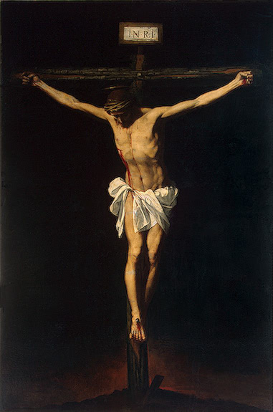
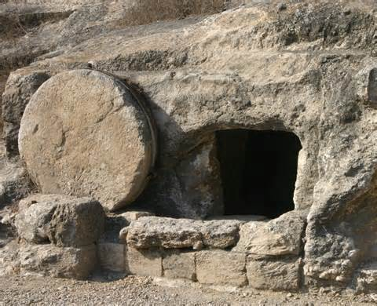
The Gospel
Romans 5:10,11

Slide 22
Giving comfort by speaking the gospel!
Uncleanness
Guilt
Sin
Shame
Brokenness

Slide 23
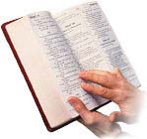
What is the Gospel?
1 C
1 Corinthians 15:1-4
Now, brothers, I want to remind you of the gospel
I preached to you, which you received and on which you have taken your stand. By this gospel you are saved, if you hold firmly to the word I preached to you. Otherwise you have believed in vain. For what I received I passed onto you as of first importance:
that Christ died for our sins according to the Scriptures, that he was buried, that he was raised on the third day according to the Scriptures

Slide 24
“Creedal Focus”
(First Article)
“therefore surely we ought to thank, praise, serve and obey him.”
(Second Article)
“All this Christ has done that I may live under him and serve him in everlasting righteousness”, innocence and blessedness.”
“”

Slide 25
Biblical Peacemaking is the Holy Spirit’s work…
“Walther: Thesis III
Law and Gospel “is taught only by the Holy Spirit in combination with experience”

