Slide 1
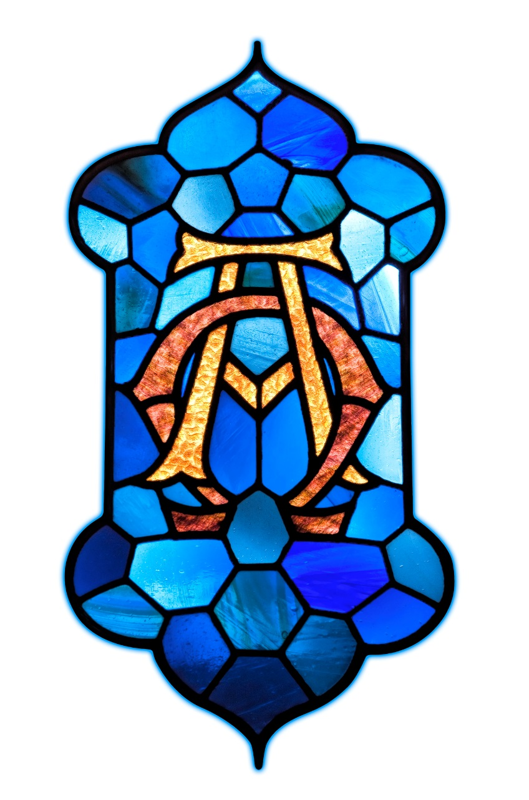
Welcome to Speak Lord 2016
Law and Gospel

Slide 2
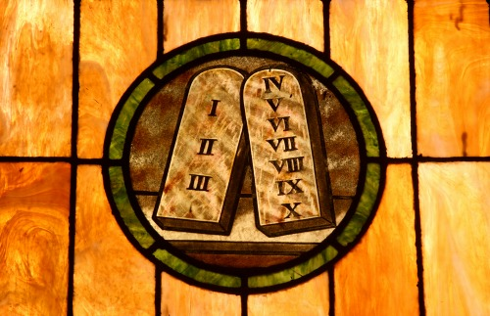
Law: God’s good design for His human creatures

Slide 3
Main questions:
How to think about the Law?
What is the Law?
What does the Law do?
What is the role of the Law for Christians?
Dangers of false teachings

Slide 4
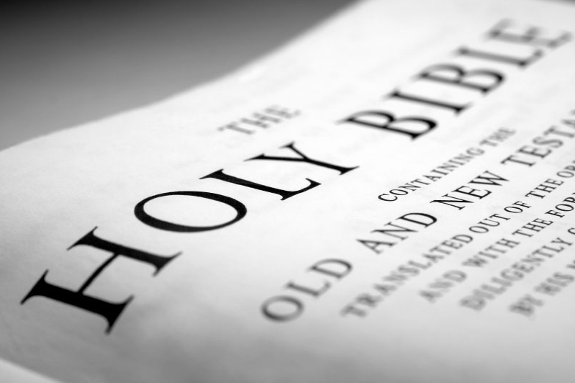
What is our highest authority?

Slide 5
“We believe, teach, and confess that the only rule and guiding principle according to which all teachings and teachers are to be evaluated and judged are the prophetic and apostolic writings of the Old and New Testaments alone, as it is written, “Your word is a lamp to my feet and a light to my path” (Ps. 119:105﻿), and Saint Paul: “If . . . an angel from heaven should proclaim to you something contrary, . . . let that one be accursed!” (Gal 1:8) (FC, Epitome)

Slide 6
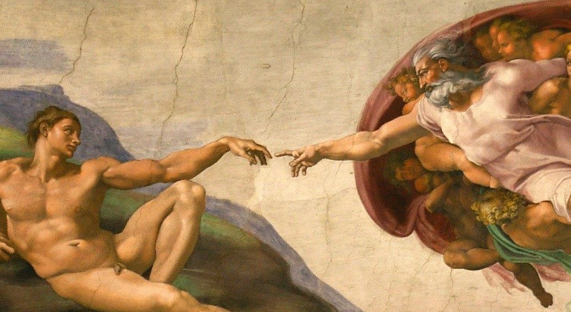
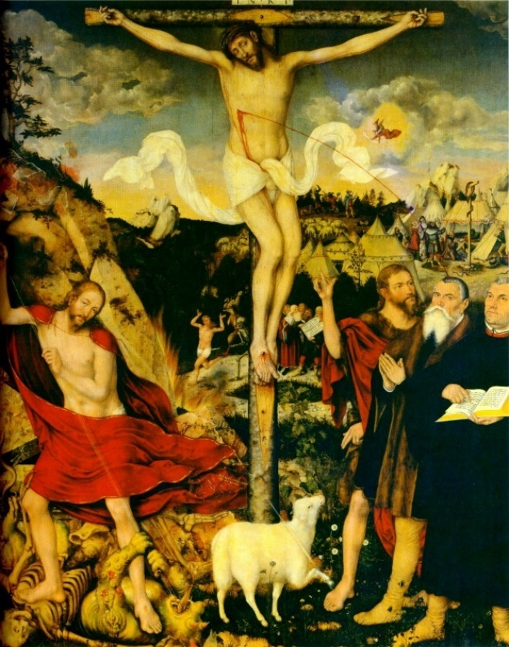
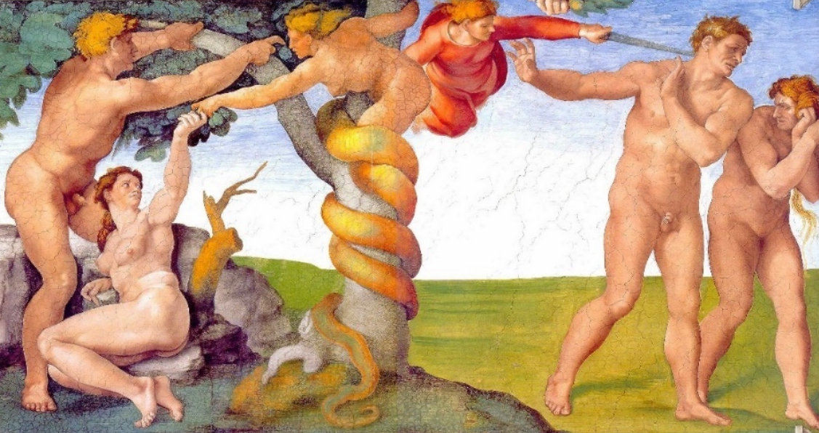

[1] How to think about the Law?
The Bible in 4 Big events:
  Creation
  Fall
  Christ event
  New Creation

Slide 7

What do we learn?
From the Creation:
  God’s identity
  Goodness of creation
  Our identity & what the Law is

Slide 8
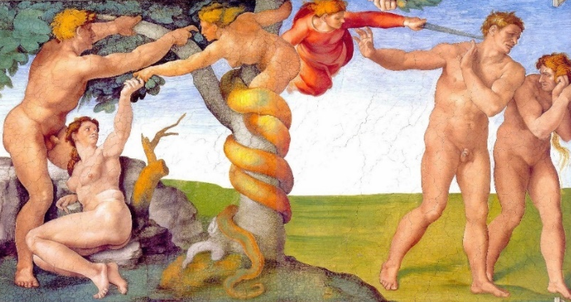
What do we learn?
From the Fall:
  What is wrong with this world and with us
  The depth of our corruption
  The depth of God’s love

Slide 9

What do we learn?
From the Christ event:
  Who Jesus was
  The magnitude of Christ event
  What God has done to save and restore His creation

Slide 10
What do we learn?
From the New Creation:
  God’s plan for His creation
  Our ultimate hope
  The mission of the Church

Slide 11
Why is this Big 4 so important?
  With this framework, the Bible can be the only rule and guiding principle;
  Without it we become like the world, – driven by desires and feelings (culture focused on self)

Slide 12
[2] What is the Law?
God’s very good design for His human creatures (Gen 1:31).
Where is this written?
  Image and likeness (Gen 1:26-27)
    God’s representatives …
    … who act according to His will

Slide 13
[2] What is the Law?
What does the Image & likeness give us?
  Identity
  Dignity / worth
  Security / daily bread
  Meaning
  Joy

Slide 14
[2] What is the Law?
God’s very good design.
Where is this written?
  Two Great Commandments (Mt 22)
  The Ten Commandments (Ex 20)
Also – Luther’s teaching on Two kinds of righteousness [2KR].
  Rigteousness – what is it?
  2KR - this is our theology

Slide 15
How to think about the 10 Commandments?
God | Gift | Commandment
What are these gifts?
  1st – God Himself
  2nd – God’s name, access
  3rd – God’s presence, rest

Slide 16
God | Gift | Commandment
What are these gifts?
  4th – Parents, order
  5th – Life, wellbeing
  6th – Marriage, sexuality
  7th – Possessions
  8th – Reputation and truth
  9th and 10th – Contentment and gratitude

Slide 17
[2] What is the Law?
God is the Creator
He has created us to live according to His design (Law)
To understand the Law (10C) = to understand God’s wisdom
To live accordingly = to be fully human

Slide 18
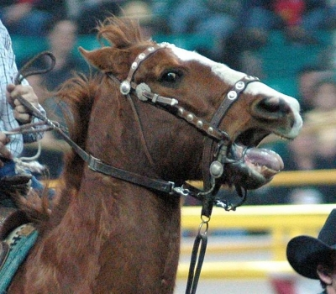


[3] What does the Law do?
Three functions of the Law:
  Curb
  restrains evil
  Mirror
  shows our sin
  Guide
  teaches God’s wisdom and how to love God and our neighbour

Slide 19
[3] What does the Law do?
1st function: curb
How does it work?
  Through our conscience
  Through our parents
  Through law enforcement
  Through rewards/God’s blessings

Slide 20
[3] What does the Law do?
1st function: curb
What are the effects?
  Order, peace, justice
  ‘Good’ people
Think! What happens when the ‘curbs’ are taken away?
Also: the Law crushes those who go against it.

Slide 21
[3] What does the Law do?
2nd function: mirror
How does it work?
  When God’s Law is revealed to us
  Shows our sin:
    Thoughts – words – actions
    NASA project ☺

Slide 22
[3] What does the Law do?
2nd function: mirror
How does it work?
  Accuses, makes sin alive, reveals God’s wrath
  Prepares for the Gospel
  Effects? Despair or Pride. Leads to repentance.

Slide 23
[3] What does the Law do?
3rd function: guide
How does it work?
  When we are justified, reconciled, forgiven
  We want to please our dear Lord
  How do you love your God? By keeping His commandments. (Ex 20)

Slide 24
[3] What does the Law do?
3rd function: guide
How does it work?
  We desire to learn God’s wisdom (Ps 1, 119)
Effects? Living according to God’s good design leads us into blessed life.

Slide 25
[3] What does the Law not do?
Remember, the Law is good, even very good (Gen 1:31), holy and just (Rom 7:12), but nevertheless:
  The Law can not change our hearts
  The Law can not save us
? Then what can ?

Slide 26
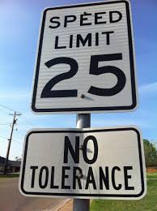
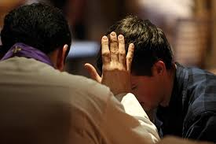
[4] What is the role of the Law for Christians?
All three functions are present:
  Curb in daily life
  Mirror preparing for Confession
  Guide shows God’s wisdom and instructs us how to love God

Slide 27
From the Large Catechism:
(1st part: The 10 Commandments)
Thus we have the Ten Commandments, a summary of divine teaching, as to what we are to do in order that our whole life may be pleasing to God [2KR], and the true fountain and channel from and in which everything must arise and flow that is to be a good work, so that outside of the Ten Commandments no work or thing can be good or pleasing to God, however great or precious it be in the eyes of the world.

Slide 28
From the Large Catechism:
(2nd part: The Creed)
The Creed sets forth to us everything that we must expect and receive from God, and, to state it quite briefly, teaches us to know Him fully. And this is intended to help us do that which according to the Ten Commandments we ought to do.

Slide 29
From the Large Catechism:
(3rd part: The Lord’s Prayer)
For since we are so situated that no man can perfectly keep the Ten Commandments, even though he have begun to believe … nothing is so necessary as that we should continually resort to the ear of God, call upon Him, and pray to Him, that He would give, preserve, and increase in us faith and the fulfilment of the Ten Commandments.

Slide 30
[5] Dangers of false teachings
There are 2 dangerous tendences:
  Self-justification by keeping the Law (legalism)
  Self-justification by neglecting the Law (antinomianism)
  In reality they both are very similar

Slide 31
Summary of the Biblical teaching on the Law
  God’s good design for humans
  After the Fall it performs three functions (curb, mirror, guide)
  Jesus came to restore our humanity [2KR]
  As forgiven children of God we strive to live according to God’s design

Slide 32
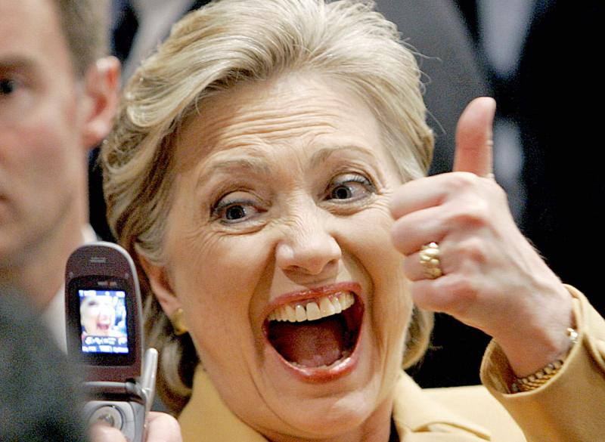
[5] Dangers of false teachings
Neglecting the Law: the story goes like this…
  The Law is baad… Jesus is goood…
  The Law reigned before Christ
  Now Jesus Christ has come and has freed us from the Law
  Now we live under the Gospel and we don’t care about the Law anymore … we are free to do…

Slide 33
[5] Dangers of false teachings!
False, un-Biblical, ignores the Biblical narrative
Implies that Jesus didn’t come to restore, but to abolish our humanity
Uses the Gospel as an excuse to do what Adam and Eve did. ‘We don’t need God’s Law anymore. We will be like gods, knowing good and evil’.

Slide 34
[5] Dangers of false teachings!
If you call anything in the Bible ‘Law’, it gives us licence to disregard it, for we live under the Gospel, don’t we?!
But, if the Word of God (Law) doesn’t determine what is right and what is wrong, and how to love God, then who does?

Slide 35
[5] Dangers of false teachings!
We do…
But what if/when we disagree? Who is right? How can we even know? There are no more criteria…
Then we need a new highest commandment – don’t judge!

Slide 36
[5] Dangers of false teachings!
Then it is not about the truth anymore, but about power-games
About new ‘correct’ narrative
Then some can define what is right and wrong and how to love God and whoever objects their ideas is called unloving …

Slide 37
The Law: God’s good design
Those who love me … keep my commandments. (Exo 20:6)
Blessed is the man […] who delights in the Law of the LORD, and on His Law meditates day and night. (Ps 1:1-2)
If you love me, you will keep my commandments. (John 14:15)
For this is the love of God, that we keep His commandments. (1John 5:3)

Slide 38
Law: God’s good design for His human creatures

