Slide 1
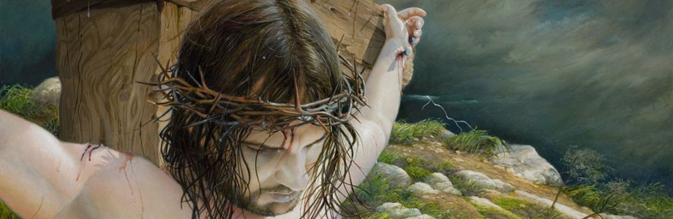
What is
the Gospel?

Slide 2
What is
the Gospel?
What the Gospel is

Slide 3
What is
the Gospel?
What the Gospel is (and is not)

Slide 4
What is
the Gospel?
What the Gospel is (and is not)
How the Bible teaches the Gospel

Slide 5
What is
the Gospel?
What the Gospel is (and is not)
How the Bible teaches the Gospel
The implications of the Gospel for our lives

Slide 6
1 Corinthians 15:1-9
Now I would remind you, brothers, of the Gospel I preached to you, which you received, in which you stand, and by which you are being saved, if you hold fast to the word I preached to you—unless you believed in vain. For I delivered to you as of first importance what I also received: that Christ died for our sins in accordance with the Scriptures, that he was buried, that he was raised on the third day in accordance with the Scriptures, and that he appeared to Cephas, then to the twelve. Then he appeared to more than 500 brothers at one time, most of whom are still alive, though some have fallen asleep. Then he appeared to James, then to all the apostles. Last of all, as to one untimely born, he appeared also to me. For I am the least of the apostles, unworthy to be called an apostle, because I persecuted the church of God.

Slide 7
1 Corinthians 15:1-9
Now I would remind you, brothers, of the Gospel I preached to you, which you received, in which you stand, and by which you are being saved, if you hold fast to the word I preached to you—unless you believed in vain. For I delivered to you as of first importance what I also received: that Christ died for our sins in accordance with the Scriptures, that he was buried, that he was raised on the third day in accordance with the Scriptures, and that he appeared to Cephas, then to the twelve. Then he appeared to more than 500 brothers at one time, most of whom are still alive, though some have fallen asleep. Then he appeared to James, then to all the apostles. Last of all, as to one untimely born, he appeared also to me. For I am the least of the apostles, unworthy to be called an apostle, because I persecuted the church of God.

Slide 8
1 Corinthians 15:1-9
Now I would remind you, brothers, of the Gospel I preached to you, which you received, in which you stand, and by which you are being saved, if you hold fast to the word I preached to you—unless you believed in vain. For I delivered to you as of first importance what I also received: that Christ died for our sins in accordance with the Scriptures, that he was buried, that he was raised on the third day in accordance with the Scriptures, and that he appeared to Cephas, then to the twelve. Then he appeared to more than 500 brothers at one time, most of whom are still alive, though some have fallen asleep. Then he appeared to James, then to all the apostles. Last of all, as to one untimely born, he appeared also to me. For I am the least of the apostles, unworthy to be called an apostle, because I persecuted the church of God.

Slide 9
1 Corinthians 15:1-9
Now I would remind you, brothers, of the Gospel I preached to you, which you received, in which you stand, and by which you are being saved, if you hold fast to the word I preached to you—unless you believed in vain. For I delivered to you as of first importance what I also received: that Christ died for our sins in accordance with the Scriptures, that he was buried, that he was raised on the third day in accordance with the Scriptures, and that he appeared to Cephas, then to the twelve. Then he appeared to more than 500 brothers at one time, most of whom are still alive, though some have fallen asleep. Then he appeared to James, then to all the apostles. Last of all, as to one untimely born, he appeared also to me. For I am the least of the apostles, unworthy to be called an apostle, because I persecuted the church of God.

Slide 10
1 Corinthians 15:1-9
Now I would remind you, brothers, of the Gospel I preached to you, which you received, in which you stand, and by which you are being saved, if you hold fast to the word I preached to you—unless you believed in vain. For I delivered to you as of first importance what I also received: that Christ died for our sins in accordance with the Scriptures, that he was buried, that he was raised on the third day in accordance with the Scriptures, and that he appeared to Cephas, then to the twelve. Then he appeared to more than 500 brothers at one time, most of whom are still alive, though some have fallen asleep. Then he appeared to James, then to all the apostles. Last of all, as to one untimely born, he appeared also to me. For I am the least of the apostles, unworthy to be called an apostle, because I persecuted the church of God.

Slide 11

The Gospel is:

Slide 12
The Gospel is:
… not good advice!

Slide 13
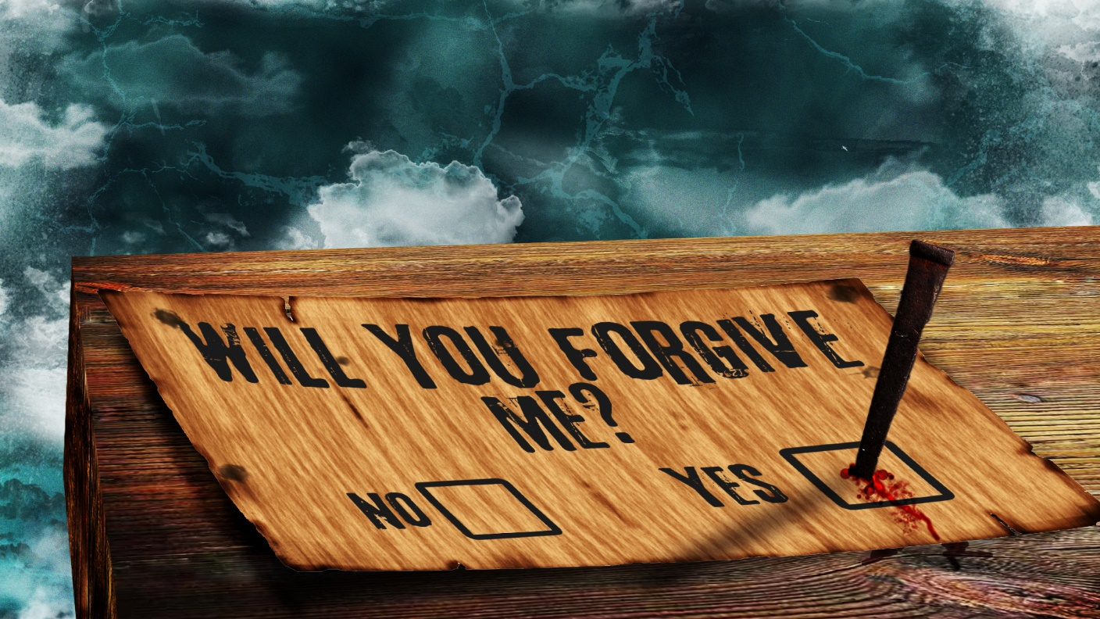

Slide 14
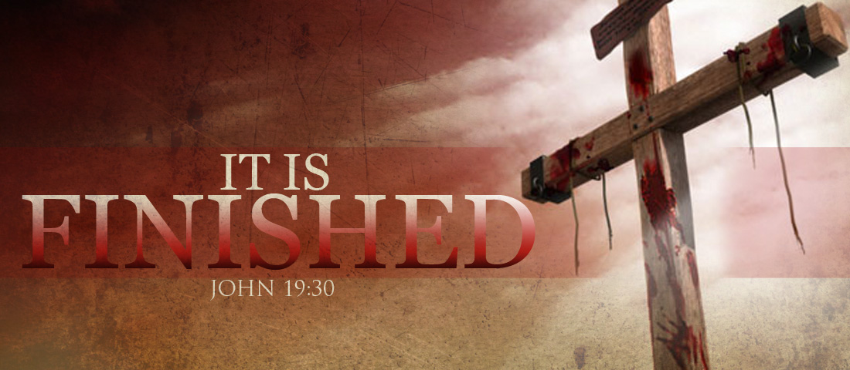
PAID
IN FULL

Slide 15
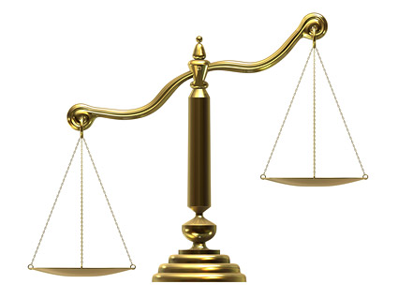
BAD
GOOD
Forgiveness for the deserving?

Slide 16
GOOD
BAD
Forgiveness for the deserving?

Slide 17
BAD
CHRIST
Forgiveness for the deserving?

Slide 18
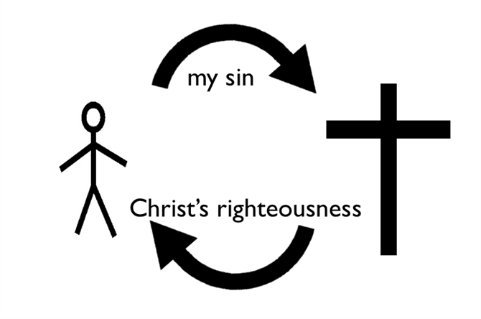
At the heart of the Gospel is the great exchange

Slide 19


Slide 20
The Undeserved Kindness of God

Slide 21


Slide 23
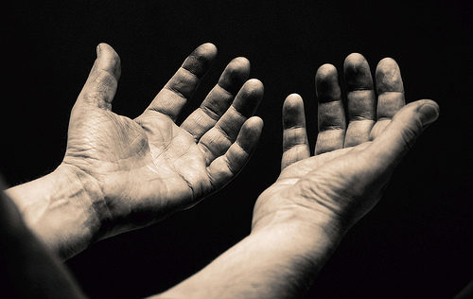
Saved by Faith Alone

Slide 24
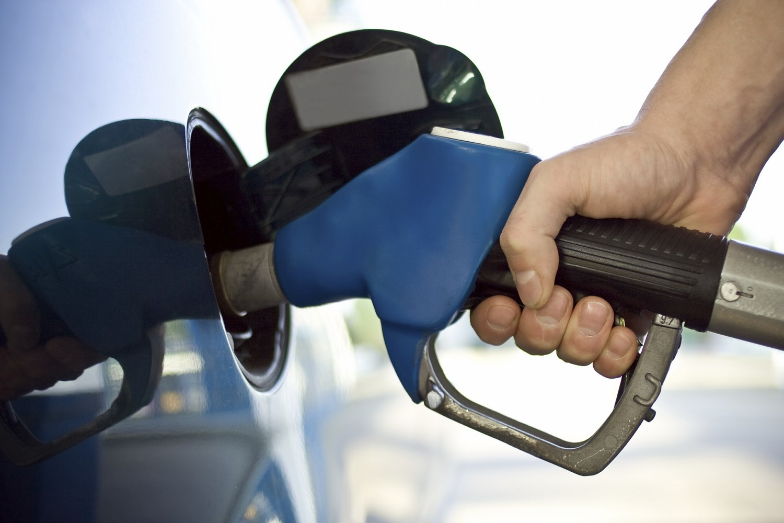
X
The Gospel is not that God fuels us up so that we can save ourselves

Slide 25
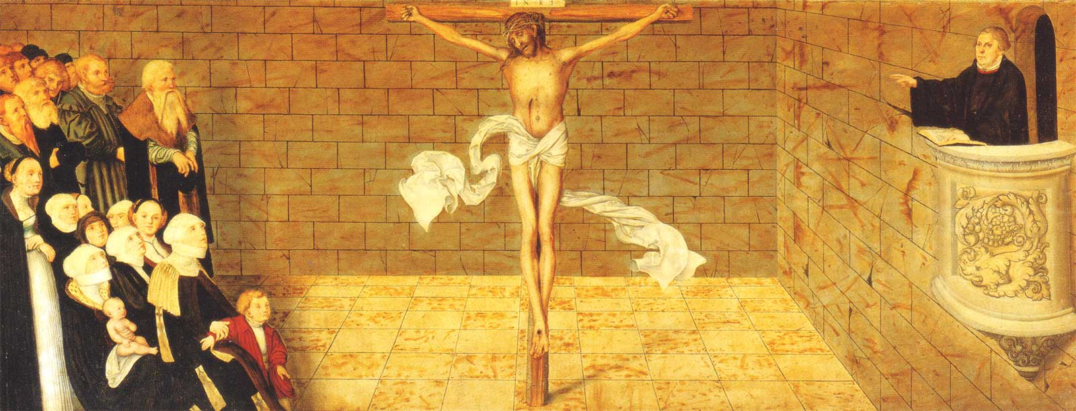
Saved by Faith Alone … In Christ Alone

Slide 26
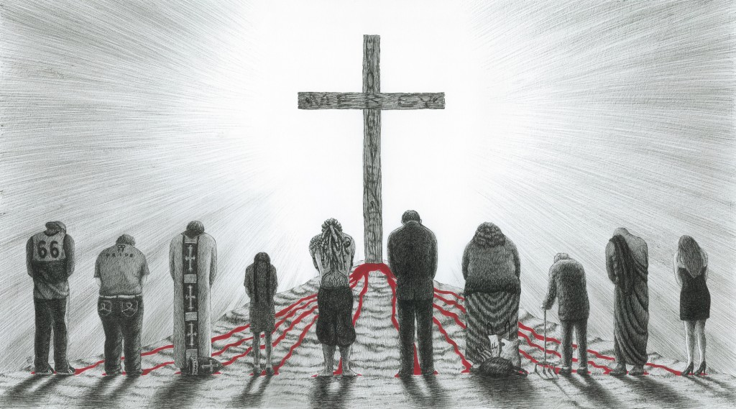

Slide 27
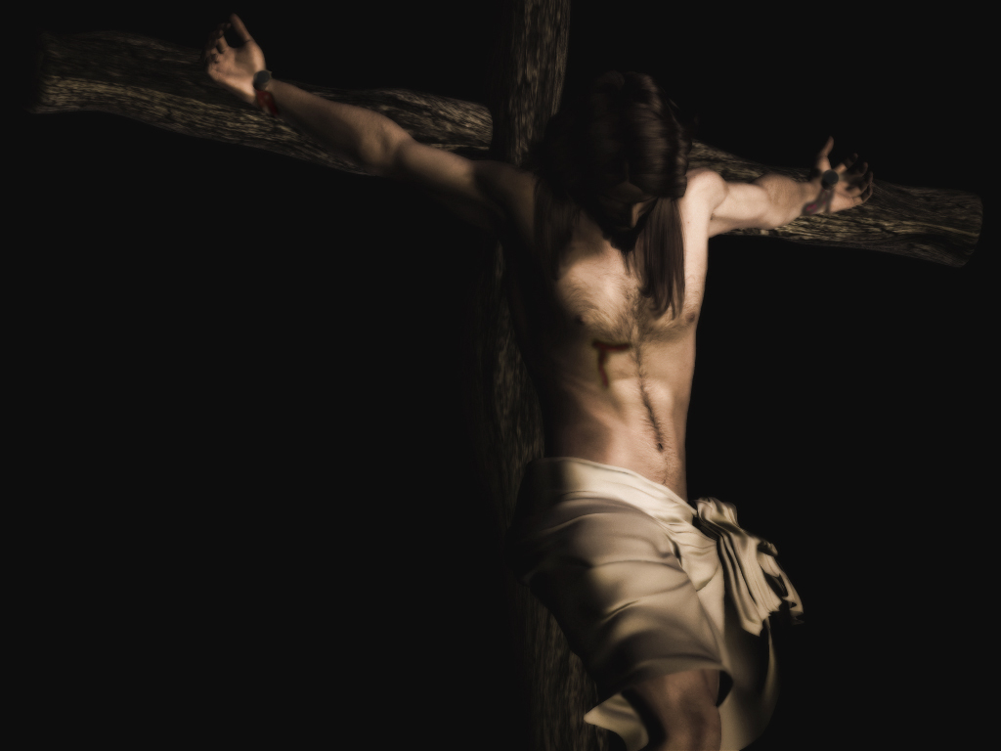
The Gospel is not just any good news.

Slide 28
The Gospel is not just any good news.
It is specifically the good news of what Christ has done to bring us salvation.

Slide 29
The Gospel is not love in a general sense.

Slide 30
The Gospel is not love in a general sense.
The Gospel is not even God’s love in a general sense.

Slide 31
The Gospel is not love in a general sense.
The Gospel is not even God’s love in a general sense.
The Gospel is that God loved us in this specific way, that he sent his Son to be our Saviour.

Slide 32
The Gospel is not that we will be saved if we get all our doctrine right, or belong to a visible church body that gets all its doctrine right.

Slide 33
The Gospel is not that we will be saved if we get all our doctrine right, or belong to a visible church body that gets all its doctrine right.
The Gospel is that we will be saved if we look to Jesus for forgiveness of all our sins.

Slide 34
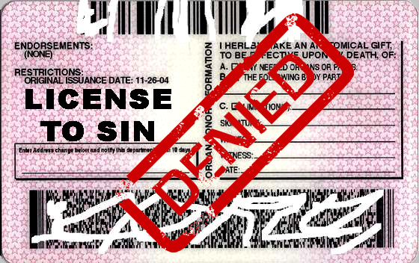
The Gospel
is not an
excuse to sin

Slide 35
The Gospel
is not an
excuse to sin
but the best reason to
love and serve God

Slide 36
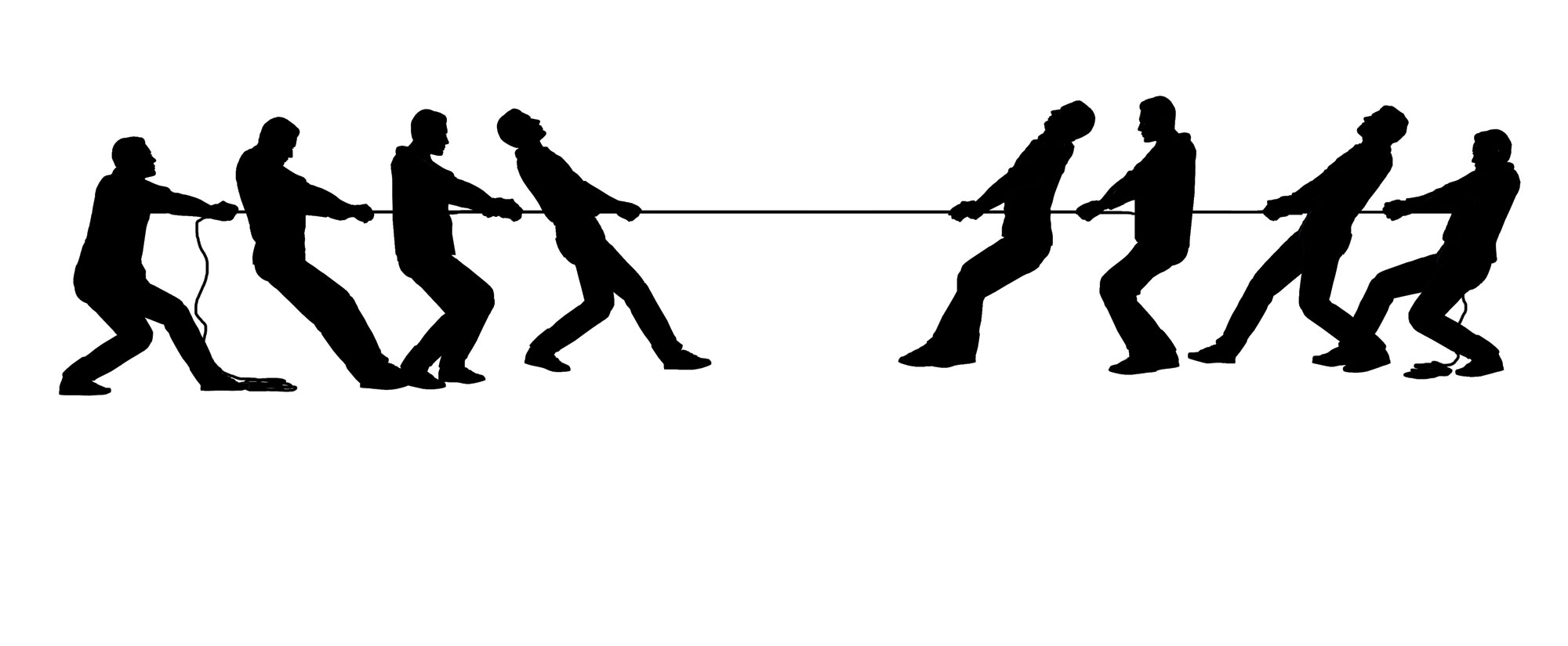
The Gospel is not something we need to hold in tension with the Law
Law
Gospel

Slide 37
The Gospel is not something we need to hold in tension with the Law
Law
Gospel
Is the law then contrary to the promises of God? Certainly not! For if a law had been given that could give life, then righteousness would indeed be by the law. (Galatians 3:21)

Slide 38


The Gospel is not that God is lenient

Slide 39
The Gospel is not that God is lenient,
but that he judges us on the basis of Christ’s worthiness rather than our own.

Slide 40

The Gospel is not simply that God is merciful in a general sense.

Slide 41


The Gospel is not simply that God is merciful in a general sense.
It is that he promises to be merciful through Jesus Christ

Slide 42
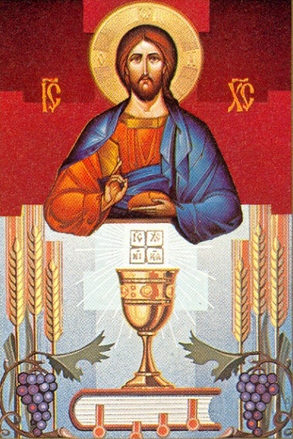
The Gospel is Sacramental

Slide 43
The Gospel is Sacramental
Therefore it is “for you”

Slide 44


Slide 45
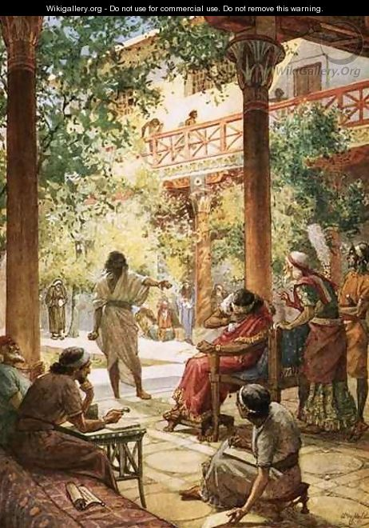

Slide 46
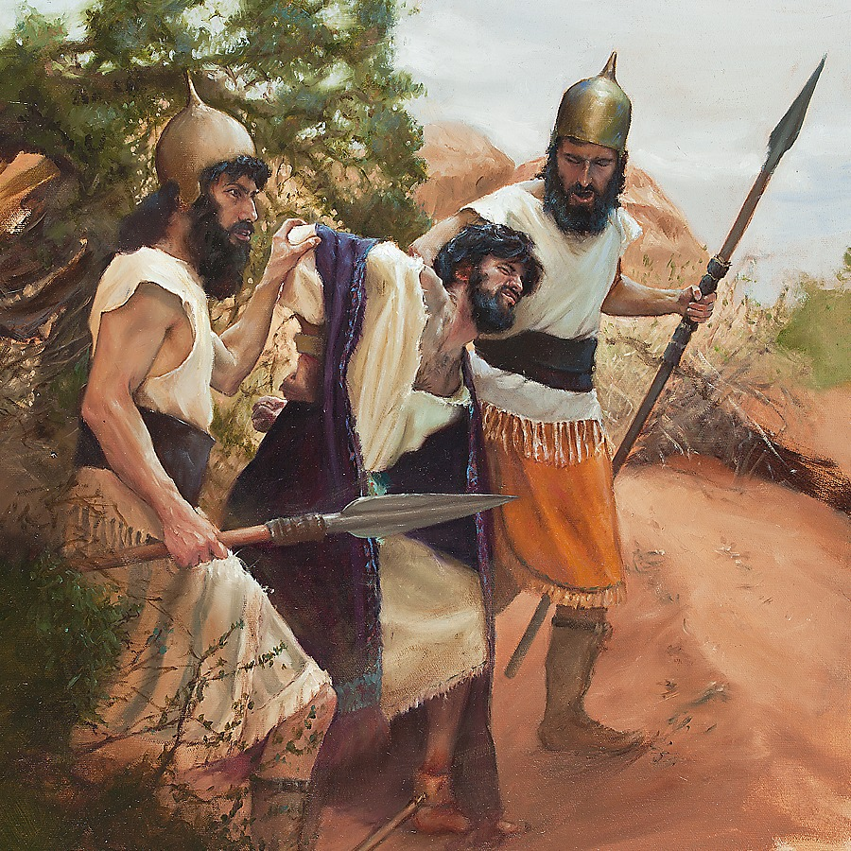

Slide 47
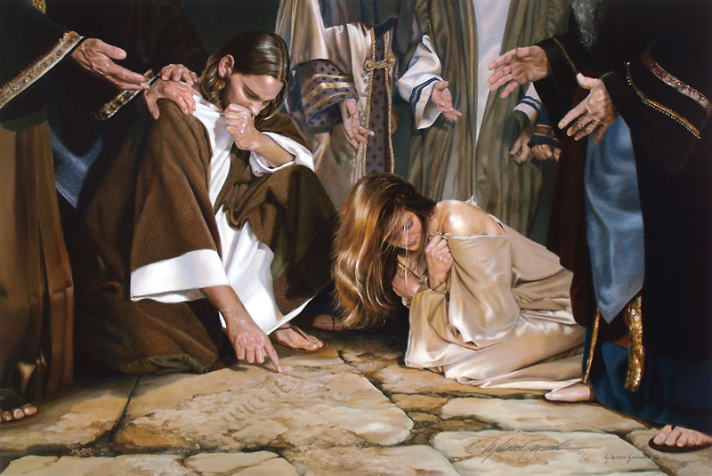

Slide 48
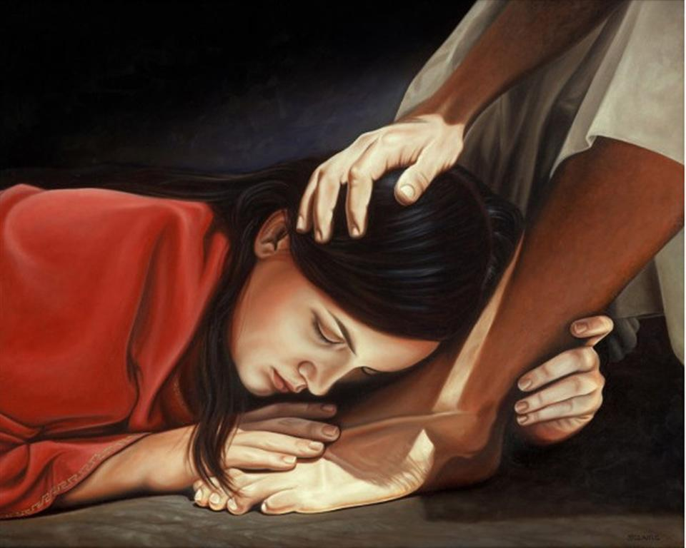

Slide 49
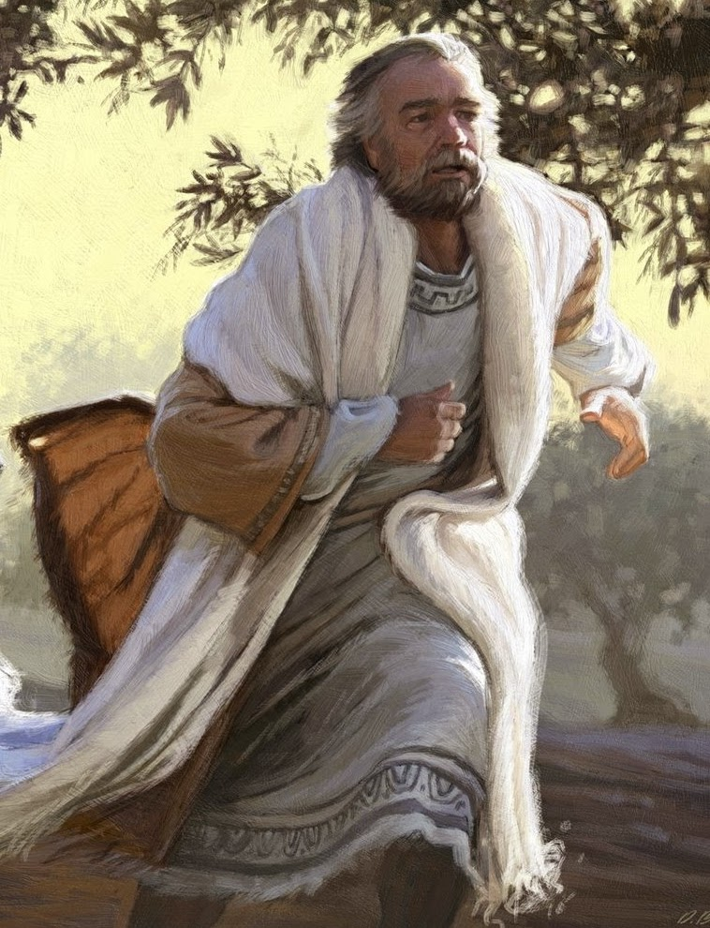

Slide 50
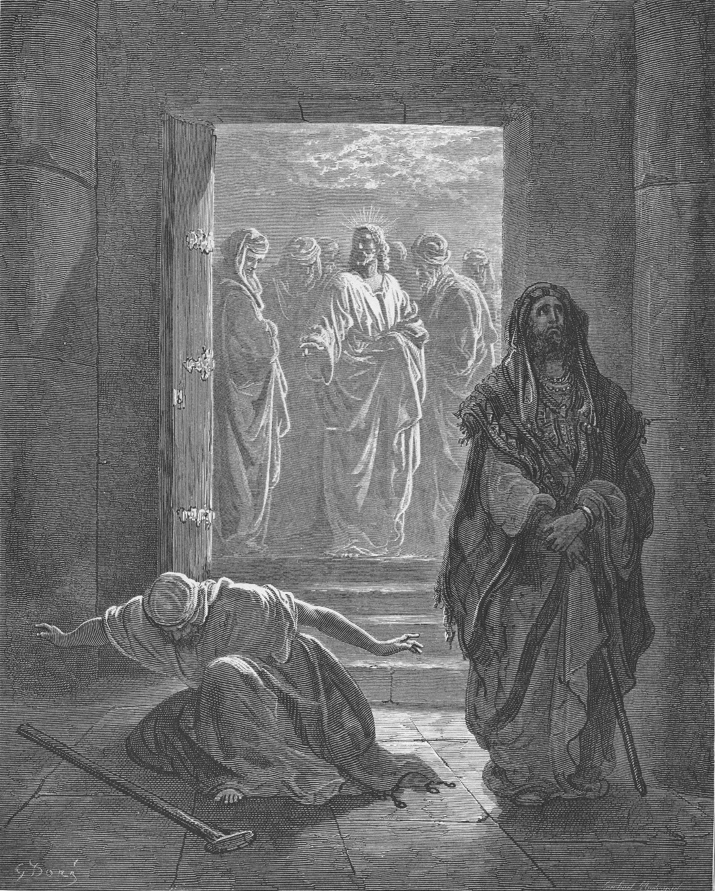

Slide 51
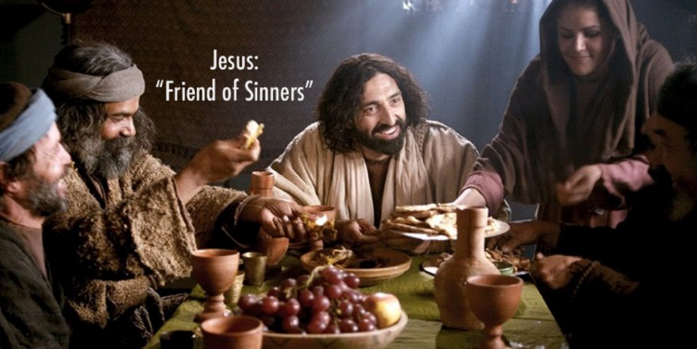

Slide 52
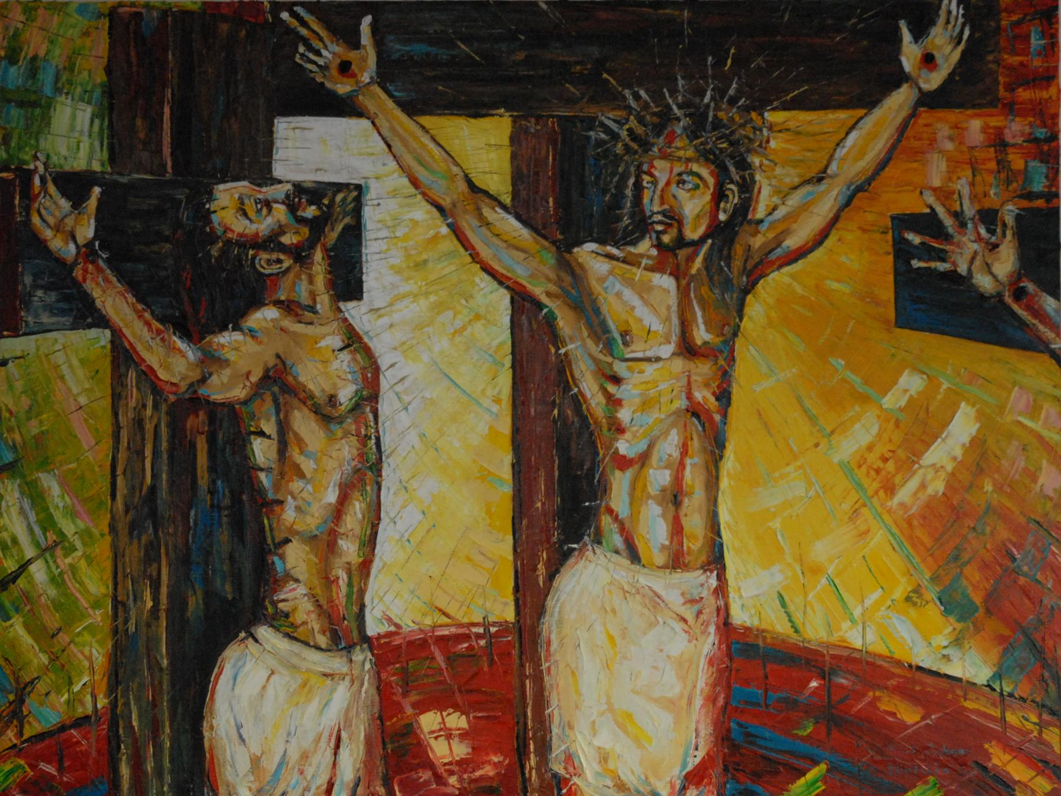

Slide 53
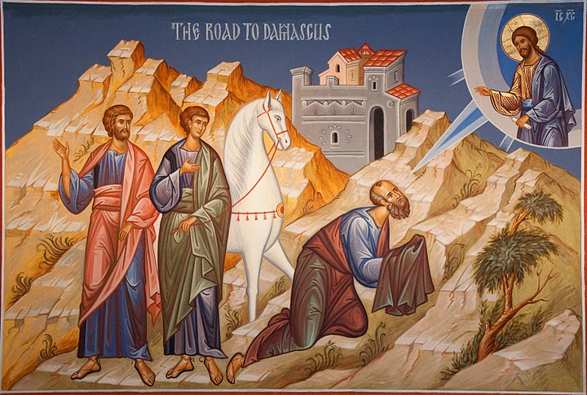

Slide 54
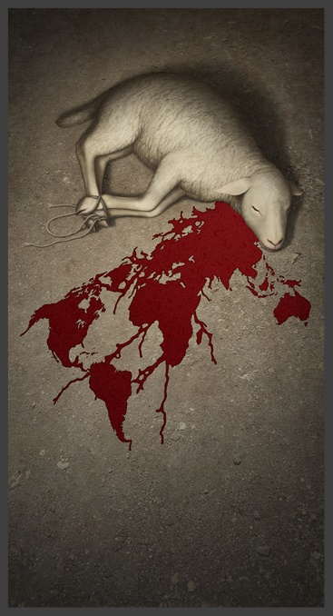
The Lamb of God who takes away the sin of the world

Slide 55

RECONCILED
US
GOD

Slide 56
Free from all guilt, shame, and condemnation
RECONCILED
US
GOD

Slide 57
Free from all guilt, shame, and condemnation
Victory over the devil
RECONCILED
US
GOD

Slide 58
Free from all guilt, shame, and condemnation
Victory over the devil
Everlasting Life
RECONCILED
US
GOD

Slide 59
Free from all guilt, shame, and condemnation
Victory over the devil
Everlasting Life
Basis for living at peace with each other
RECONCILED
US
GOD

Slide 60
Free from all guilt, shame, and condemnation
Victory over the devil
Everlasting Life
Basis for living at peace with each other
Rely on God to care for us and give us every good thing by grace
RECONCILED
US
GOD

