Slide 1
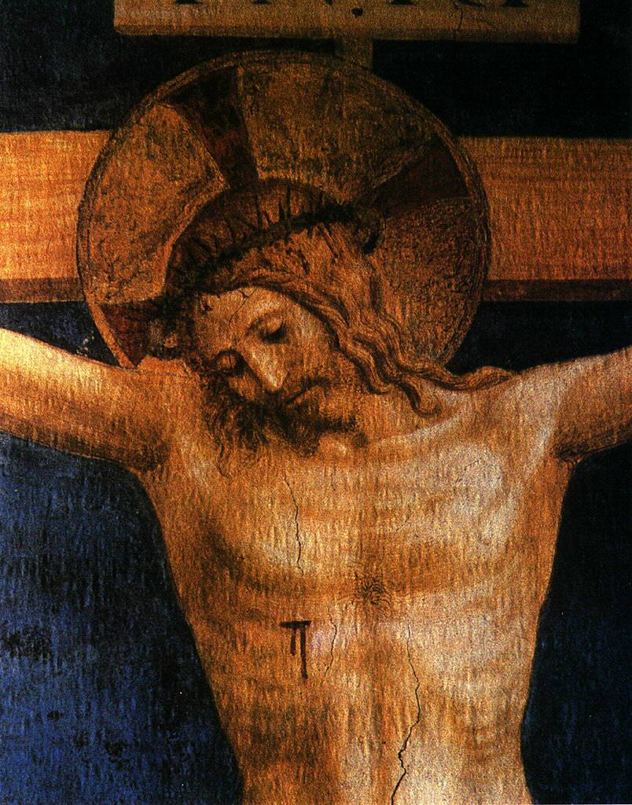
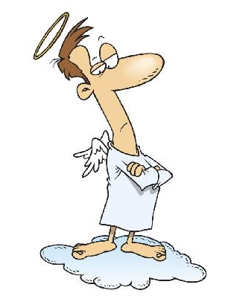
Vs.

Slide 2
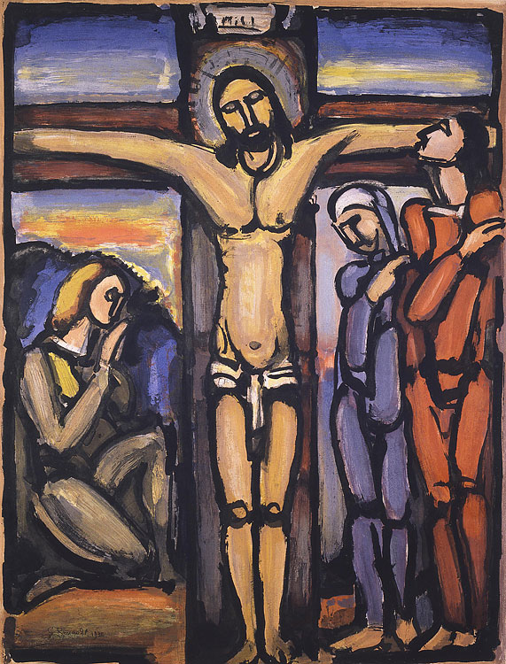

Slide 3

Christ alone is our ladder to heaven

Slide 4
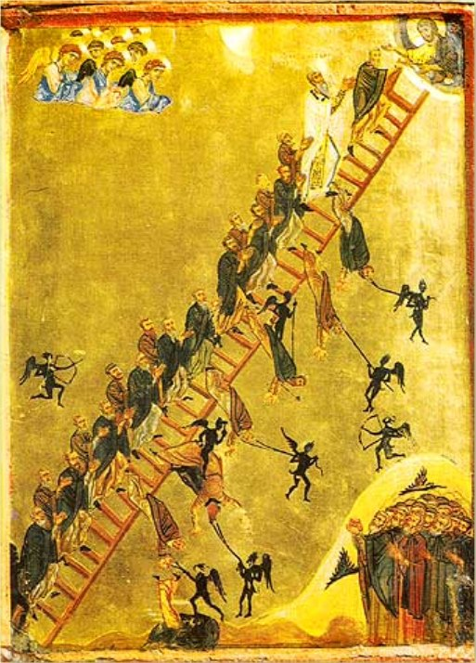
We are constantly tempted to think we can climb up to God by ourselves

Slide 5
X

Slide 6
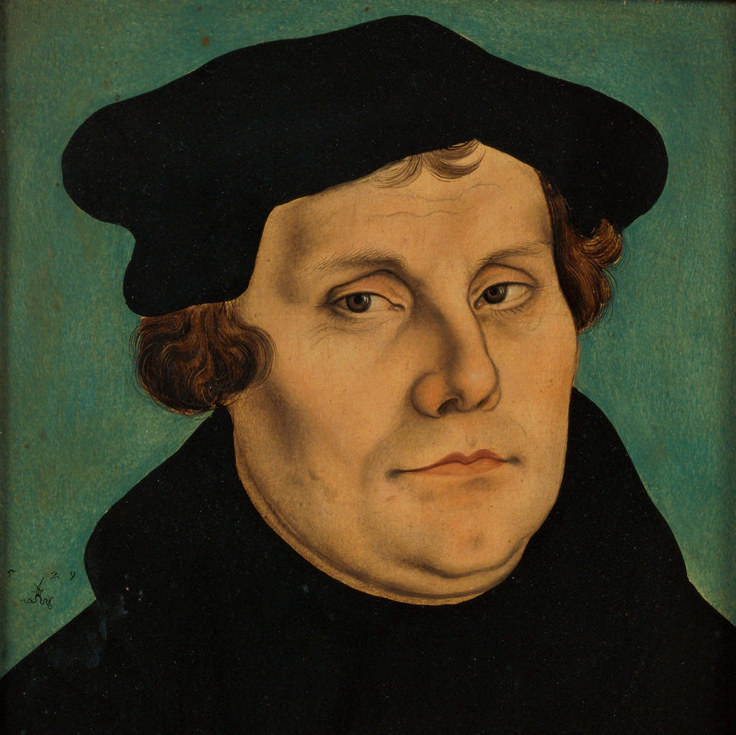
Whoever seeks righteousness apart from faith and through works denies God and makes himself into God. This is what he thinks: “If I do this work, I shall be righteous. I shall be the victor over sin, death, the devil, the wrath of God, and hell; and I shall attain eternal life.” Now what is this, I ask you, but to arrogate to oneself a work that belongs to God alone, and to show that one is God?
- Luther, Galatians Commentary (1535), LW 26:258

Slide 7
Therefore it is completely insane when the papists and the Turks do battle against each other about religion and the worship of God; each contends that he has the true religion and worship of God. In fact, even the monks are not in agreement among themselves; one wants to be regarded as holier than another merely because of some foolish outward ceremonies, when in their hearts the opinions of them all are more alike than eggs.

Slide 8
For this is what they all think: “If I do this work, God will have mercy on me; if I do not, He will be wrathful.” Therefore every man who falls away from the knowledge of Christ necessarily rushes into idolatry; for he must invent a form for God that does not exist anywhere.
- Luther, Galatians Commentary (1535), LW 26:397

Slide 9
2 Reasons why we justify ourselves

Slide 10

2 Reasons why we justify ourselves
Pride

Slide 11
2 Reasons why we justify ourselves
Pride
“A self-righteous person is a thief of the divine glory and also an idolater, because he lays claim to God’s glory for himself.”
- Luther, Lectures on Isaiah [1527-30], LW 17:162

Slide 12

2 Reasons why we justify ourselves
Pride
God’s Law has been written on our hearts
Remember Sabbath
Do not lie
God’s Law
Love Neighbour
Love God
Do not kill
Do not steal
Honour parents

Slide 13

2 Strategies for self-justification
1. Keeping the Law

Slide 14

2 Strategies for self-justification
1. Keeping the Law

Slide 15
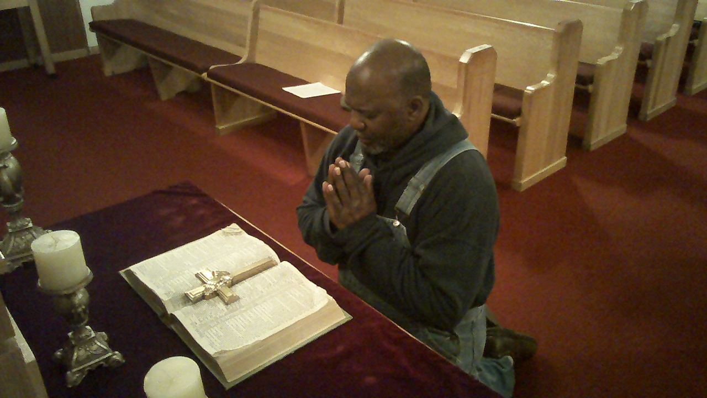
2 Strategies for self-justification
1. Keeping the Law

Slide 16


2 Strategies for self-justification
1. Keeping the Law
2. Silencing the Law

Slide 17
2 Strategies for self-justification
1. Keeping the Law
2. Silencing the Law
“When sin is ignored, a false innocence is presumed.”
- Luther, Antinomian Theses and Disputations, WA 39/1:348.19–20.

Slide 18

5 Consequences of Self-Justification: 1. Hypocrisy

Slide 19


5 Consequences of Self-Justification:
2. An unstable conscience
Pride
Or Despair

Slide 20
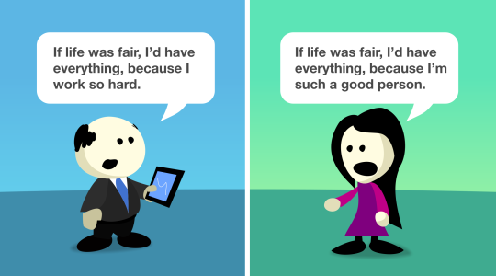
5 Consequences of Self-Justification:
3. A sense of entitlement rather than thanksgiving

Slide 21
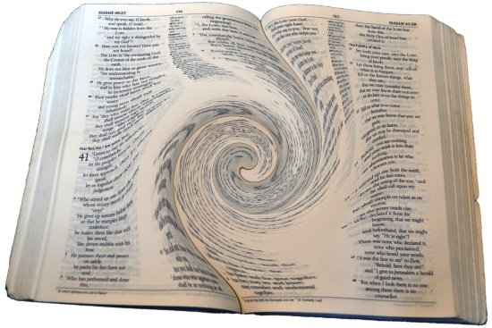
5 Consequences of Self-Justification:
4. Twisting the Scriptures

Slide 22
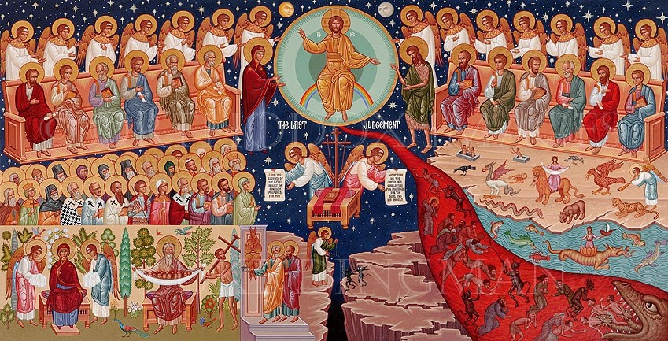
5 Consequences of Self-Justification: 5. Condemnation

Slide 23
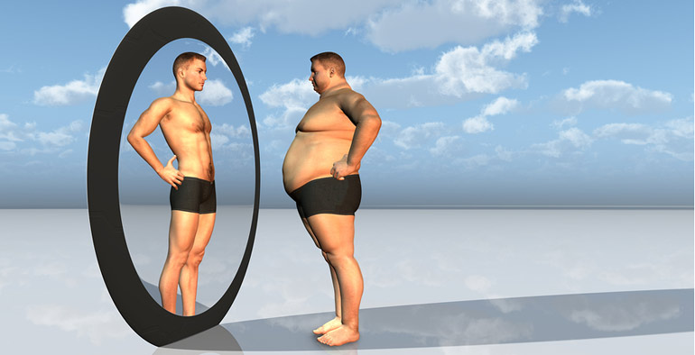
Distorting Our Self Image

Slide 24


Slide 25
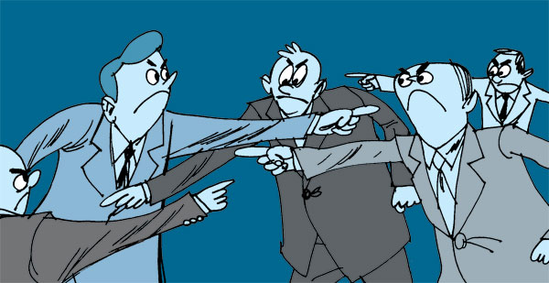
Passing the Buck

Slide 26
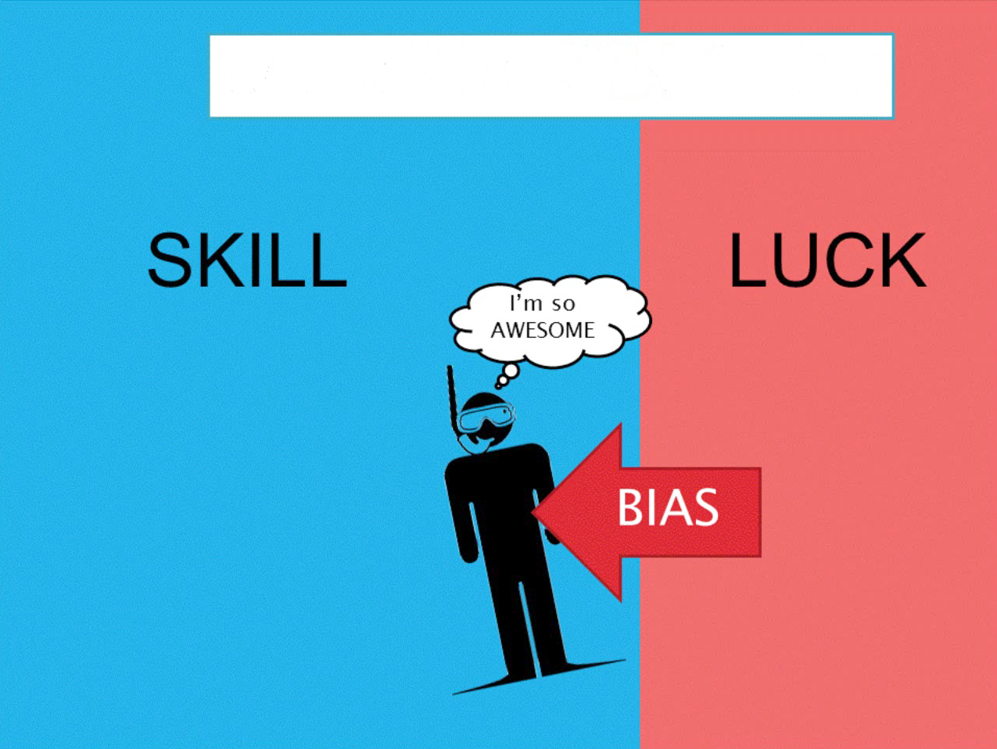
IF YOU SUCCEED

Slide 27

Shift the boundary between wrong and right to suit our own behaviour

Slide 28


Slide 29
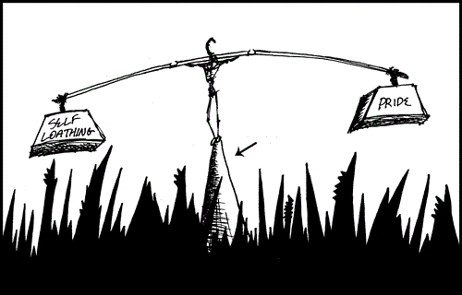
Unstable Quest for Self-Esteem
Inadequate foundation of the self

Slide 30
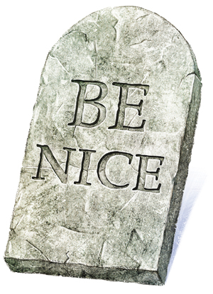
The Gospel of
Moralistic Therapeutic Deism

Slide 31


Slide 32
X
Freedom?

Slide 33
X
True Freedom

