Slide 1

Law & Gospel – Seelsorge

Slide 2

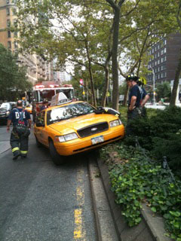

Diagnosis – The Law & Its Functions/Uses
Lex semper accusat!

Slide 3
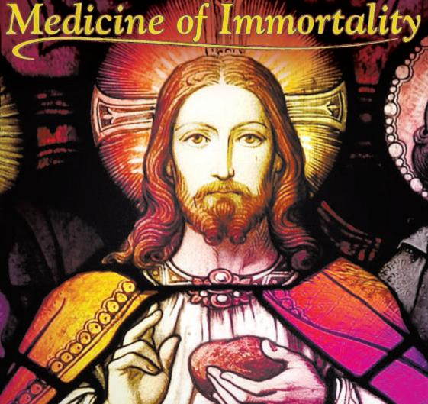
Prescription – The Gospel

Slide 4
Law Gospel
Shows my sin Shows my Savior
Demands upon me Promises to me
Condemns me Forgives me
Kills me Resurrects me
Cheap Law cheapens the Gospel.
Christ FULFILLED the Law;
He did not overthrow it.

Slide 5

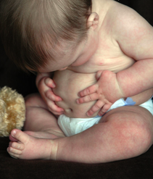
Justification & Sanctification
Rechtfertigung und Heiligung
Man’s attempts to justify himself before God:
Pietism
Mysticism
Rationalism

Slide 6
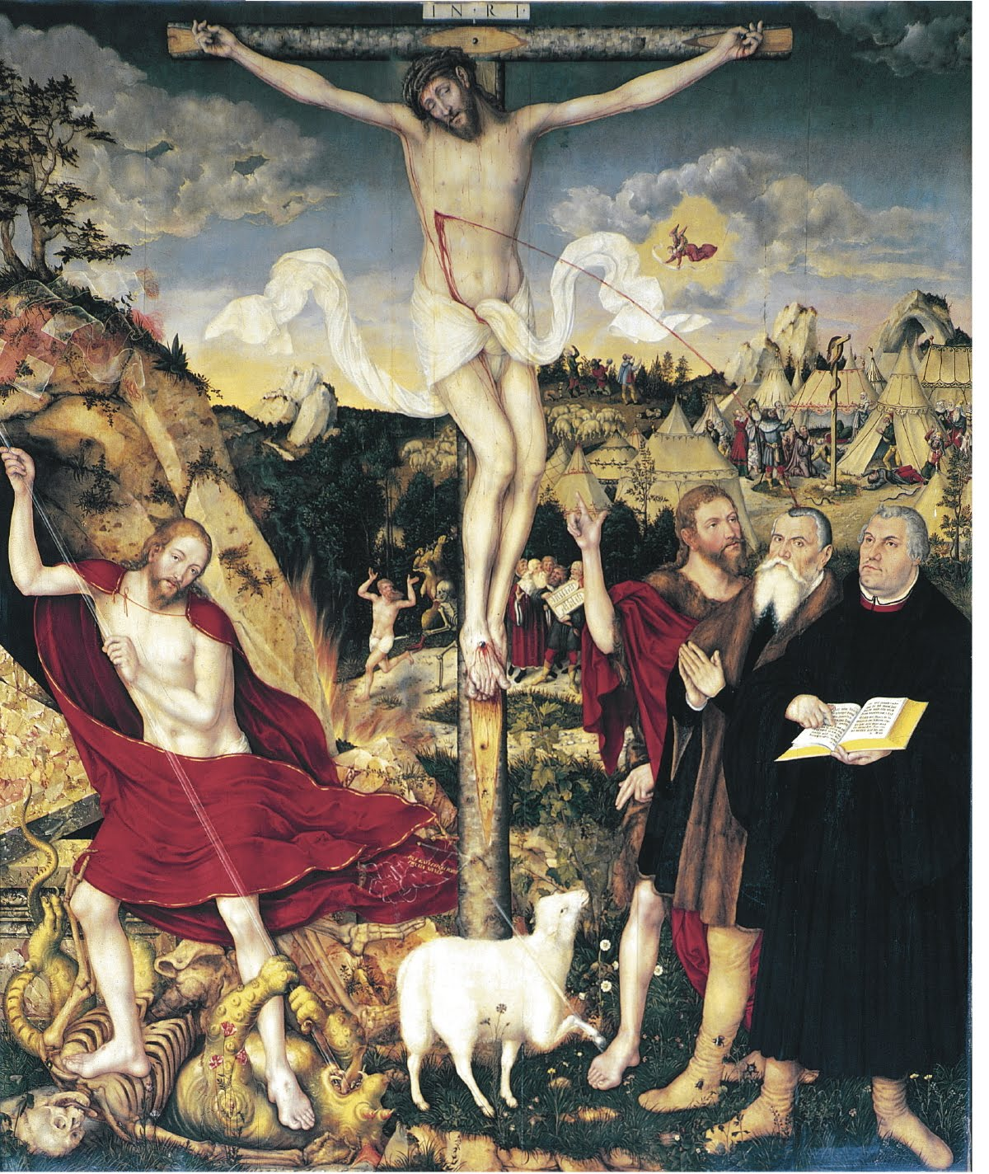
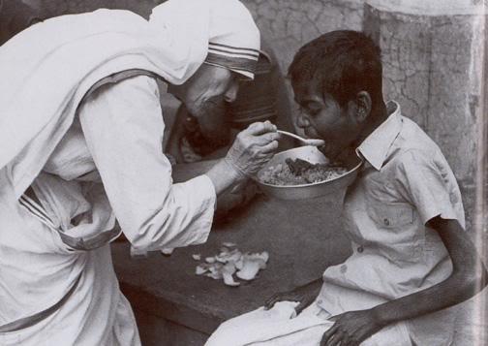
Faith is focused extra nos
For justification, faith’s focus
For sanctification, faith’s focus

Slide 7
Sanctification flows from Justification
Who needs my good works?
Good works as grateful response
Good works as “proof that faith is living” (Salvation Unto Us Has Come, Speratus)
Ephesians 2:8-10
We give thanks to You, almighty God, that You have refreshed us through this salutary gift, and we implore You that of Your mercy You would strengthen us through the same in faith toward You and in fervent love toward one another; through Jesus Christ, Your Son, our Lord, who lives and reigns with You and the Holy Spirit, one God, now and forever. Amen.
Good works are defined by the Law while the Gospel motivates & enables good works.

Slide 8
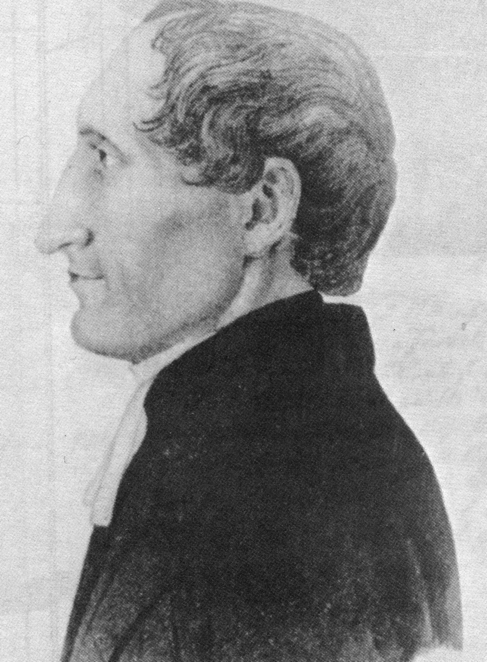
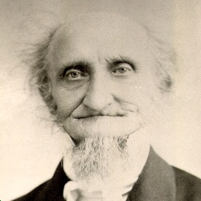
Carl Ferdinand Wilhelm Walther
1884-1885 Friday Evening Lectures
1839 – Saxon immigration to US

Slide 9




Slide 10
Thesis I – The doctrinal contents of all Holy Scripture, both of the Old and New Testament, consist of two doctrines that differ fundamentally from each other. These two doctrines are the Law and the Gospel.
Thesis II – If you wish to be an orthodox teacher, you must present all the articles of faith in accordance with Scripture, yet you must also rightly distinguish Law and Gospel.
Thesis III – To rightly distinguish Law and Gospel is the most difficult and highest Christian art – and for theologians in particular. It is taught only by the Holy Spirit in combination with experience.
Thesis IV – Understanding how to distinguish Law and Gospel provides wonderful insight for understanding all of Holy Scripture correctly. In fact, without this knowledge Scripture is and remains a sealed book.

Slide 11
Twenty-One Theses Re: How Law & Gospel are Confused
You are not rightly distinguishing Law and Gospel in the Word of God if…
VIII – …you preach the Law to those who are already in terror on account of their sins or the Gospel to those who are living securely in their sins.
IX – …you point sinners who have been struck down and terrified by the Law toward their own prayers and struggles with God…. Rather, point them toward the Word and the Sacraments.
XIII – …you explain faith by demanding that people are able to make themselves believe or at least can collaborate toward that end. Rather, preach faith into people’s hearts by laying the Gospel promises before them.
XXIII – …you use the demands, threats, or promises of the Law to try and force the unregenerate to put away theirs sins and engage in good works and thus become godly; and then, on the other hand, if you use the commands of the Law – rather than the admonitions of the Gospel – to urge the regenerate to do good.
XXV – …you do not allow the Gospel to predominate in your teaching.

Slide 12

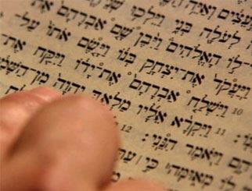
Reading the Text & Reading the Person
Why do you ask?

Slide 13
Leviticus 19:2 / 1 Peter 1:16
קְדֹשִׁ֣ים תִּהְי֑וּ כִּ֣י קָדֹ֔ושׁ אֲנִ֖י יְהוָ֥ה אֱלֹהֵיכֶֽם
Ἅγιοι ἔσεσθε, ὅτι ἐγὼ ἅγιός [εἰμι].
When do I need to hear a policy command (Law)?
When do I need to hear an indicative statement of fact (Gospel)?
Similarly, the First Commandment…
לֹֽ֣א יִהְיֶֽה־לְךָ֛֩ אֱלֹהִ֥֨ים אֲחֵרִ֖֜ים עַל־פָּנָֽ֗יַ׃
So, which is it? Policy command (Law) or statement of fact (Gospel)?
Why are you asking?

Slide 14
How then shall I preach/listen to a sermon?
What demands does God make in this text? (Law)
What deliverance does God provide in this text? (Gospel)
How does the Law found in this text speak to me specifically, convicting me as a sinner and calling me to repentance?
How does the Gospel found in this text speak to me specifically, delivering forgiveness in Christ and calling me to hope?
The Law has been properly preached when it points out MY sin (rather than the other guy’s sin).
The Gospel has been properly preached when it points me to CHRIST for full confidence and certainty.

Slide 15
How then shall I deliver pastoral/Christian care?
Example 1: Paul & the Church in Corinth
1 Corinthians 5 & 6 – Sexual immorality
2 Corinthians 2 – Restoration of the penitent
Example 2: Luther’s return from the Wartburg Castle
What about today?
What does God’s Law say of this?
What does God’s Gospel say of this?

Slide 16
End-of-Life Issues
What does God’s Law say?
What does God’s Gospel say?
Which needs to be heard right now?
Marriage Counseling
What does God’s Law say?
What does God’s Gospel say?
Which needs to be heard right now?

Slide 17
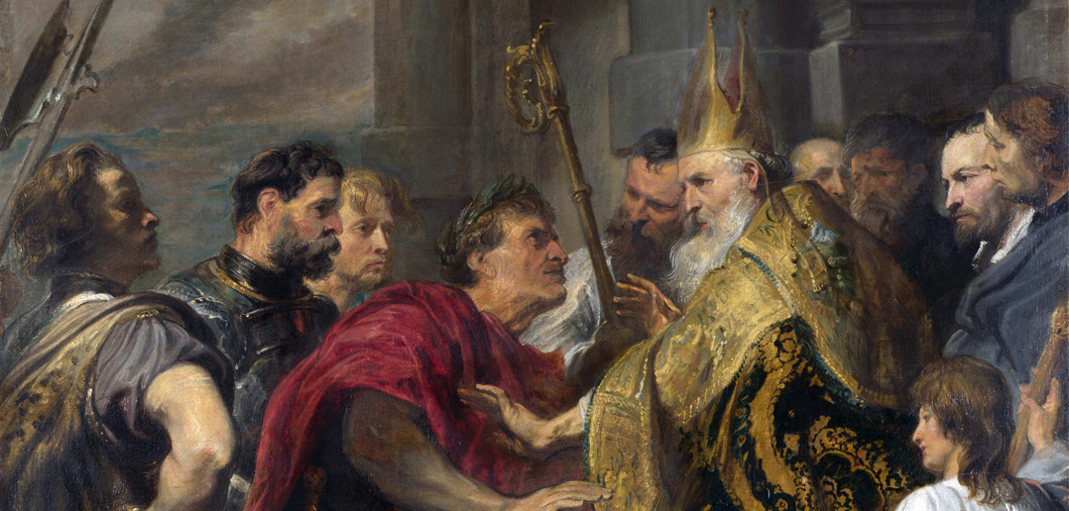
Ambrose & Theodosius (AD 390)

