Slide 1
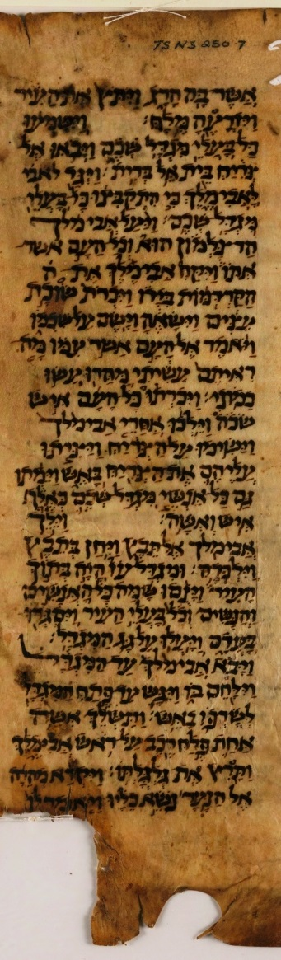
‘Speak Lord,
for your servant
is listening’
(1.Sam 3:10)

Slide 2
‘The Origins of the Scriptures
and
the Formation of the Canon’

Slide 3
How did we get
our Bible
and
have we got the right books?

Slide 4
Why is this important?
What do we confess?
We accept without reservation the Holy Scriptures of the Old and New Testaments, as a whole and in all their parts, as the divinely inspired, written and inerrant Word of God, and as the only infallible source and norm for all matters of faith, doctrine, and life. (Article II)

Slide 5
How are our Holy Scriptures unique?
Inspired?
Inerrant?
Word of God?
What about the others?
Koran?
Book of Mormons?
Etc.

Slide 6
Who is our God?
The Lord of history:
God who speaks and acts in history
„Behold, the former things have come to pass, and new things I now declare; before they spring forth I tell you of them.” (Isaiah 42:9)

Slide 7
What is the Bible?
The Bible is God’s own testimony about what He has done and spoken
or
God’s track record of promises kept and prophesies fulfilled – in our history!

Slide 8
What then are the authors of the Bible?
God’s witnesses
Old Testament
‘‘You are my witnesses...’’Isaiah 43:10, 12
New Testament
Luke, Acts, John

Slide 9
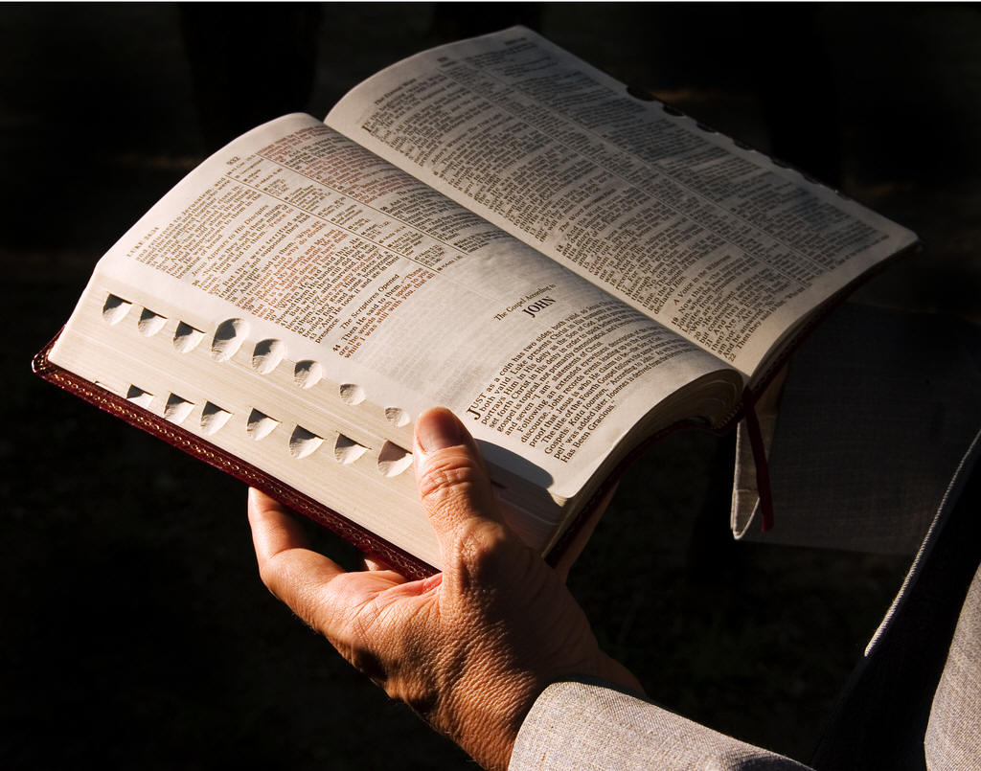
How do we today imagine the Bible?

Slide 10
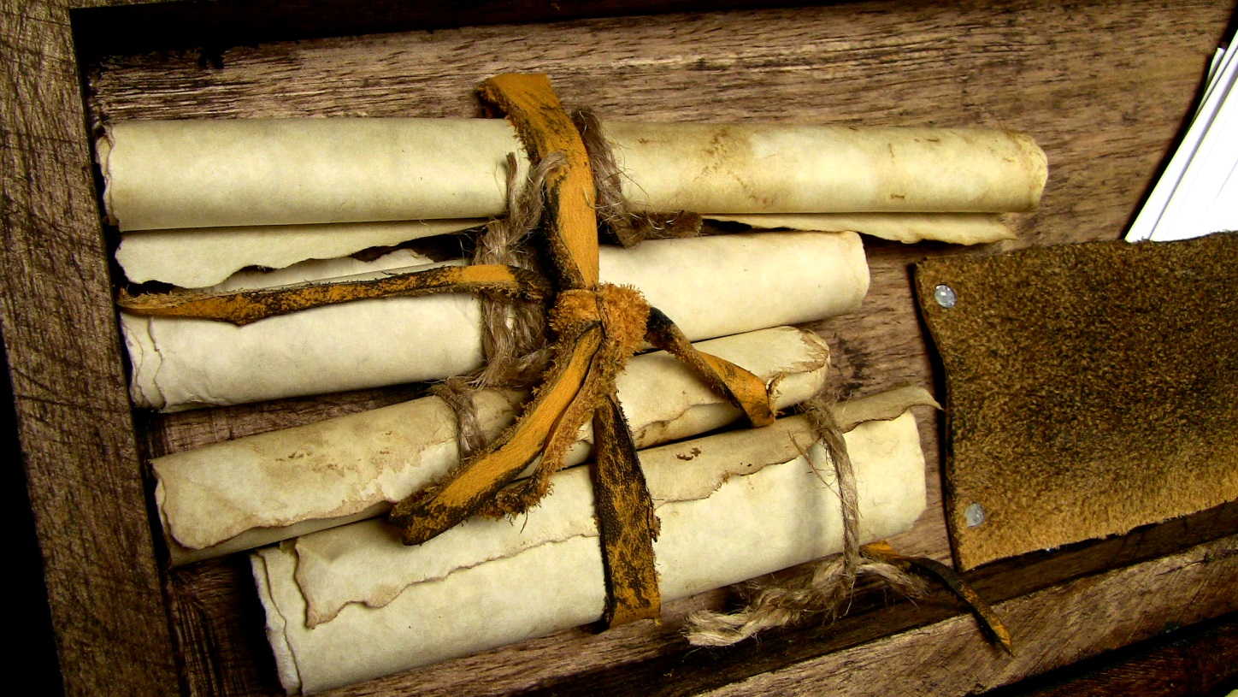
What was it like before?

Slide 11
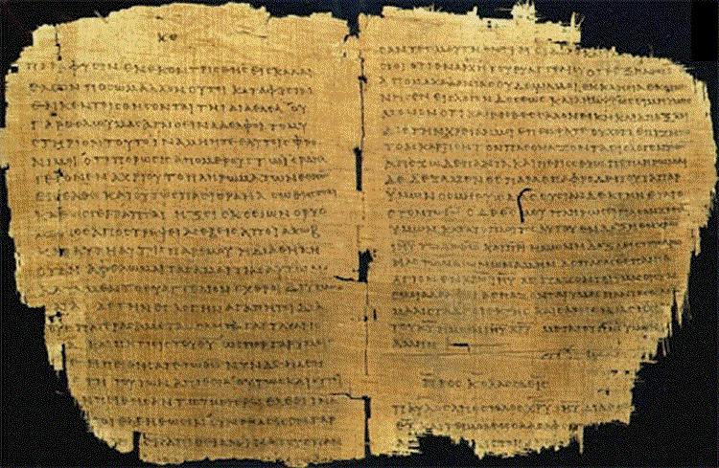
What was it like before?

Slide 12
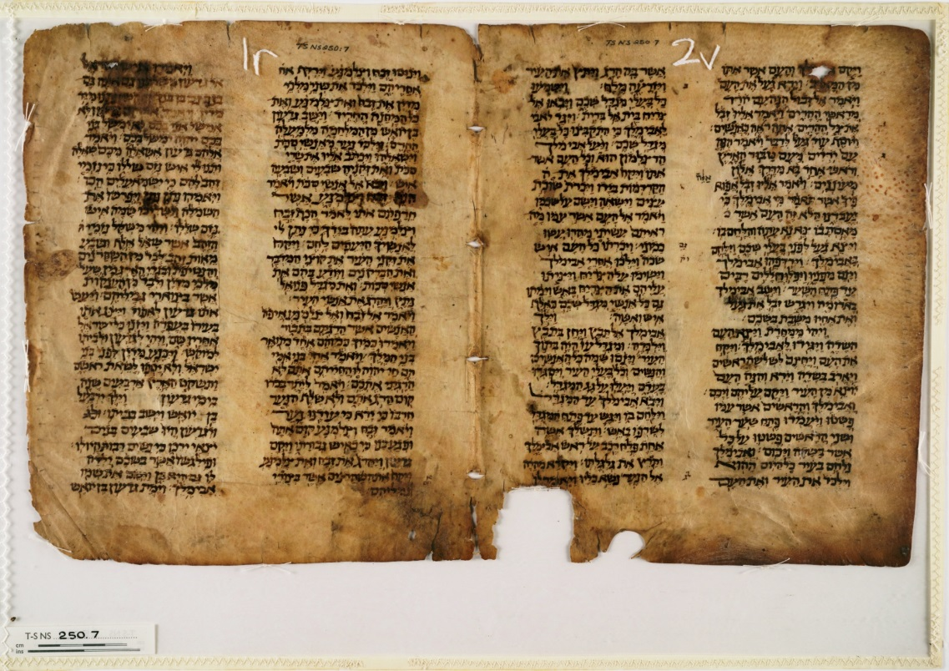
What was it like before?

Slide 13
How did we get
our Bible
and
Have we got the right books?

Slide 14
Today I will argue that:
We know a lot about the origins of the Scriptures (both the Old and the New Testament)
We know a lot about the formation of the Biblical canon
We know that we have received the same message, the same words of the Lord, that were originally given to us

Slide 15
Part I
The Old Testament

Slide 16
What is the Old Testament?
It is truly unique a book (a collection of 39 books):
  Unique period of time
  Unique authors
  Unique protagonists
  Unique worldview
  Unique purpose

Slide 17
Argument # 1
We know a lot about the origins of the Old Testament

Slide 18
How did it begin?
We know that the foundational event was the Exodus
We know that God Yahweh commanded Moses to write down what had happened and what He had commanded

Slide 19
How did Moses acquire all the information?
He used different sources:
  He was a witness of what God Yahweh did and spoke (Exodus to Deuteronomy)
  He used oral sources
  He used written sources
  The story of the city-state Ebla

Slide 20
What kind of events do we remember the best?
Unique
Emotional
Frequently retold

Slide 21
How does this apply to the orgins of the Bible?
[1] Unique:
The devastation of Egypt
Exodus
Testimonies from surrounding nations

Slide 22
How does this apply to the orgins of the Bible?
[2] Emotional:
Theophany at the Mount Sinai
Memories from the NT

Slide 23
How does this apply to the origins of the Bible?
[3] Frequently repeated
Establishing Moses’ authority
Writing & preservation
Copying
Retelling & teaching

Slide 24
What was the result?
High authority of Moses writings (Joshua 1:7-8)
The Books of Moses were stored in the Tabernacle, later in the Temple as the Temple copy
The Torah was used to evaluate other prophecies

Slide 25
Besides: ‘Principle of Moses’
God Himself calls
Confirms His authority & authority of His messenger by signs (Ex 4:2-9, 30, 19:9)
It happens before the eyes of eyewitnesses
Writings considered the Word of the Lord

Slide 26
What about other books of the Old Testament?
We don’t know about all, of course
‘Moses’ principle’ at work
  Samuel, Nathan, Gad
Writings of the prophets
Collection of the writings

Slide 27
What happened with God given books?
They were kept in the Tabernacle / in the Temple
They were copied in the Temple and elsewhere
They were used in gatherings of the faithful [?]
Circulated widely (e.g. Daniels & Jeremiah)

Slide 28
Summary for the Argument # 1
Writing of the Bible begun after Exodus and Sinai by Yahweh’s command
God established Moses’ authority
Moses wrote what God commanded
Books of Moses were stored and copied
Other books of the OT might have used the same ‘Moses’ principle’

Slide 29
Argument # 2
We know a lot about the formation of the Old Testament canon

Slide 30
When was the Old Testament canon finalized?
Late canon: 1st century (Jamnia) or even later
Early canon: soon after the last books of the Old Testament were written (sometime in 5th of 4th century BC)

Slide 31
What are the evidence for the early canon?
  [1] Ceasing of God’s Spirit
  [2] The Temple room as a canon (Maccabees, Talmud, Josephus, Ben Sirah)
  [3] Qumran – list of Holy books
  [4] New Testament evidence: Jesus and others

Slide 32
Summary for the Argument # 2
God’s Spirit ceased after the last books of the Old Testament were written
All holy books were stored and copied in the Temple
Both Jewish and Christians considered the Old Testament canon as completed long before AD

Slide 33
Arguments # 3
We know that we have received the same message, the same words of the Lord, that were originally given to us

Slide 34
What do we know about copying?
Example of Ebla (2500BC)
Moses and the priests (1400BC)
Later traditions
  Soferim, Tannaim, Amoraim
  Masoretic Tradition

Slide 35
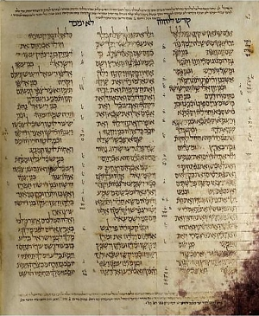
What are our oldest manuscripts?
Ben-Asher - Codex Aleppo ~925AD

Slide 36
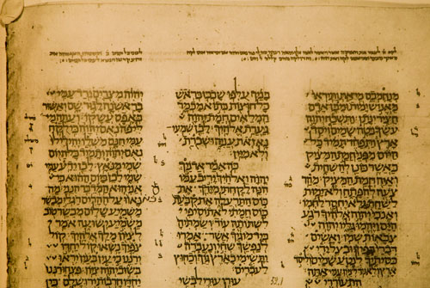
What are our oldest manuscripts?
Ben-Asher - Codex Leningradensis (1008AD)

Slide 37
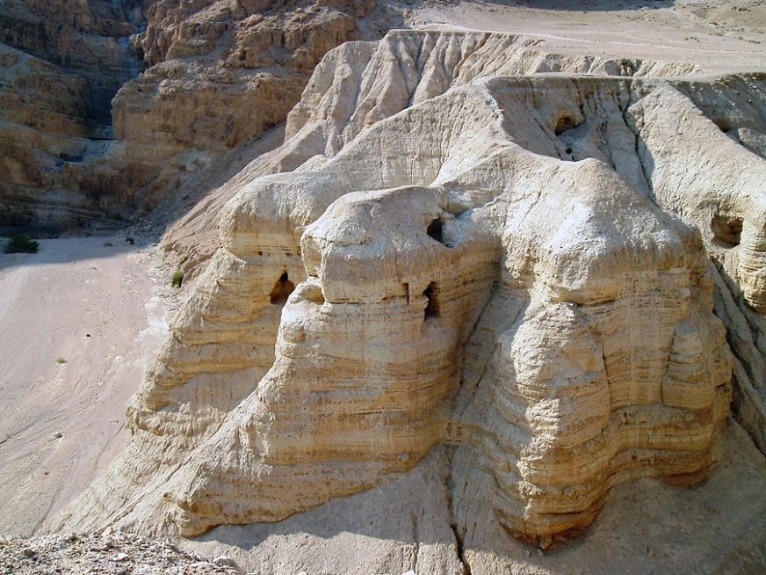
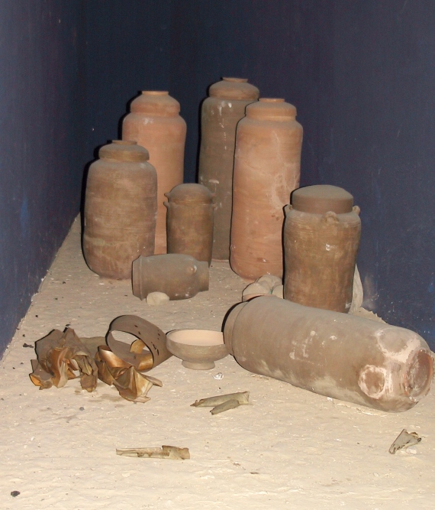
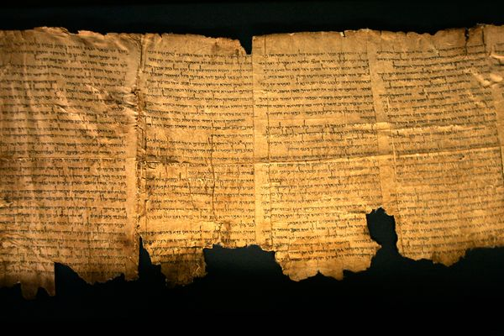
What are our oldest manuscripts?
Qumran Discoveries (3rd century BC – 1st AD)

Slide 38
Dead Sea (Qumran) Scrolls
All Old Testament books, except Esther
Some manuscripts dating from 3nd century BC
  Distance in time less than 2 centuries
Minimal differences with Aleppo and Leningradensis
  Isaiah Scroll – only 4500 [!] differences

Slide 39
How many OT manuscripts do we have today?
Hebrew – more than 3000
Greek – more than 1500
Latin – more than 8000
Syriac – more than 60
Some of these are from 3rd century BC [!]

Slide 40
Summary for the Argument # 3
Books were carefully copied – as the Word of the Lord
We have manuscripts as old as from the 3rd century BC
The earliest manuscripts do not contain significant differences (in meaning) from the later codices which are basis for our Old Testament translations

Slide 41
Summary for the Old Testament
We know about the origin of the Old Testament
We know about its writing, copying and storing
We know about the formation of the Old Testament canon
We have so many manuscripts
We know that we have got the right Old Testament

Slide 42
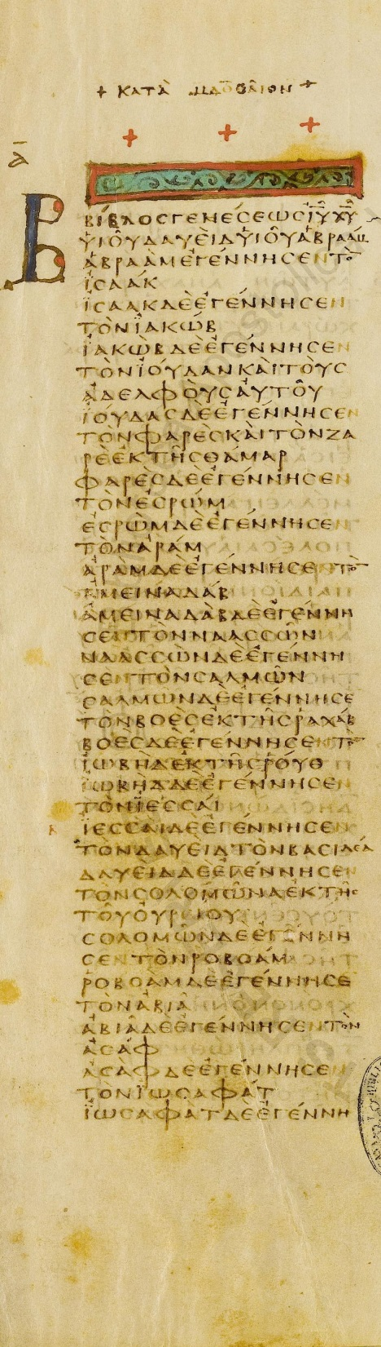
‘The Origin of the Scriptures
and
the Formation of the Canon’

Slide 43
Part II
The New Testament

Slide 44
What is the New Testament?
It is truly unique a book (a collection of 27 books):
  Unique period of time
  Unique authors
  Unique protagonists
  Unique worldview
  Unique purpose

Slide 45
Today I will argue that:
We know a lot about the origins of the New Testament
We know a lot about the formation of the New Testament canon
We know that we have received the same message, the same words of the Lord, that were originally given to us

Slide 46
Argument # 1
We know a lot about the origins of the New Testament

Slide 47
What kind of events we remember the best?
Unique
Emotional
Frequently retold

Slide 48
How does this applies to the New Testament?
Annunciation, conception and childhood
Baptism and temptations
Public ministry
Sufferings, crucifiction and death
Resurrection and ascension

Slide 49
As the Creed says...
‘I believe in Jesus Christ, his only Son, our Lord, who was conceived by the Holy Spirit, born of the Virgin Mary, suffered under Pontius Pilate, was crucified, died, and was buried; he descended into hell. On the third day he rose [again]; he ascended into heaven, seated at the right hand of God, the almighty Father, from where he will come to judge the living and the dead.’
(The Apostles’ Creed, II Article)

Slide 50
How do we know it?
From the testimonies of eyewitnesses:
Authors of Gospels
Authors of other NT writings
The New Testament testimonies
    Luke 24, Acts 1, 1 John 1, 1Peter 1, 1 Cor 15
Testimonies by ancient Roman and Greek historians [!]

Slide 51
What were they testifying about?
About the Gospel event - what does it mean?
Gospel = report about events
  Victory reports/Good news
  Gospel of Caesar Augustus
How many gospels?
  Only one Gospel - ‘Gospel according to ...’
Other NT writings explain the implications of this event

Slide 52
Argument # 2
We know a lot about the formation of the New Testament canon

Slide 53
Which were the earliest documents of the New Testament?
Paul’s letters
How many are there?
  13 (+ Hebrews?)
How many were there?
  2 more Corinthians, Laodiceans, probably even more...
Do we have the right ones?

Slide 54
How were letters written?
Authors and sribes (Rom 16:22)
Oral performance and messengers (Col 4:16)
Several copies – collection
    Seneca, Cicero
    Membrana (2 Tim 4:13)
A case for Paul’s own collection

Slide 55
What testimonies do we have?
Testimonies from the early Church Fathers
  Clement of Rome – 1 Corinthians (circa 95AD) – ‘one letter’
  Ignatius (circa 110AD), Papius (circa 130AD), Polycarpus (early 2nd century), Justin Martyr (circa 150AD)
Testimonies from early manuscripts - Paul’s letters as codices (e.g. P46)

Slide 56
Summary on canonicity of Paul’s letters:
Paul begun his ministry a few years after Jesus’ resurrection
God confirmed Paul’s authority before many eyewitnesses (‘Moses’)
Letters written between 40-ties and 60-ties AD
Authoritative right away (2 Pet 3:16)
Well known by the end of 1st century (possibly as a codex)
Testimonies from early manuscripts: only codices

Slide 57
How did we get the Gospels?
Written by the apostles, or according to their message
Why written? To bring the message to ‘all nations’
Written between 40-ties and 95AD (Gospel according to John)
Which was the first one? Mark? Matthew? John?

Slide 58
Why these four?
What about other ‘gospels’? ‘Dozens of gospels...’
These 4 were known from [at least] the beginning of the 2nd century as a codex
Read in the Divine Service soon after they were written

Slide 59
Testimonies of the Early Church Fathers
Clement of Rome (95AD) [3]
Ignatius (110AD) [4]
Papius (130AD) [4]
Justin Martyr (160AD) ‘Harmony’ [3]
Tatian (170AD) ‘Diatessaron’ [4]
Translation into other languages [4 canonical]
Irenaeus, Clement, Seraphion (end of the 2nd century) ‘received gospels’

Slide 60
Testimonies from manuscripts
Codices from the beginning of 2nd century
Always only these four
Never any other ‘gospel’ together with the canonical gospels

Slide 61
What about these other ‘gospels’?
Is there a conspiracy? (Dan Brown, Elaine Pagel, etc.)
No, there is not! ☺
The Church always knew about the others ‘gospels’

Slide 62
What about these ‘other gospel’?
They were written much later
They were written by other religious groups, not by Christians (Gnostics)
They represent totally different worldview
They never appeared together with the Four Gospel, and the Four never appeared together with these others

Slide 63
Summary on the Gospels:
Written by the apostles, or people very close to the apostles
Written between 40-ties and 90-ties AD
Authoritative right away
Well known by the beginning of 2nd century (as a codex ‘Mega Biblion’)
Testimonies from early manuscripts: always these Four

Slide 64
What about the other NT writings?
In the 2nd century considered as authoritative:
  Acts, 1 Peter, 1 John and Hebrews
Revelation, James, 2 Peter, 2 and 3 John and Judas were acepted as authoritative locally, not by the whole Church

Slide 65
Summary for the Argument # 2
Paul’s letters perceived as the Scriptures already in the 1st century and read in the Service
Four Gospels perceived as the Scriptures and read in the Service in the beginning of the 2nd century
Acts, 1 Peter, 1 John, Hebrews perceived as authoritative in the 2nd century (>90% of the NT)

Slide 66
Summary for the Argument # 2
Other writings known only locally, not accepted by the whole Church
By the 4th century the canon was mostly established, even if there was no formal list of the canonical book before 357AD
There was never a concil or any formal decision that would set the boundaries of the NT canon

Slide 67
Arguments # 3
We know that we have received the same message, the same words of the Lord, that were originally given to us

Slide 68
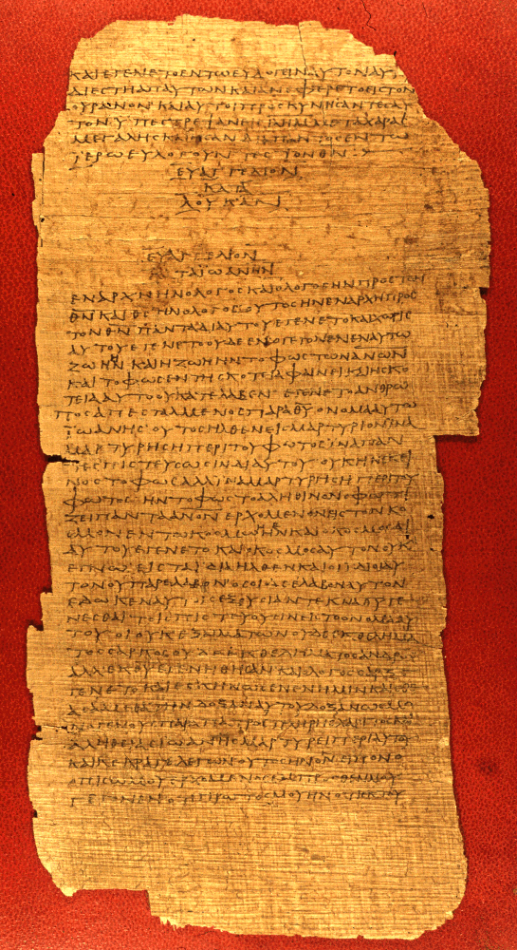
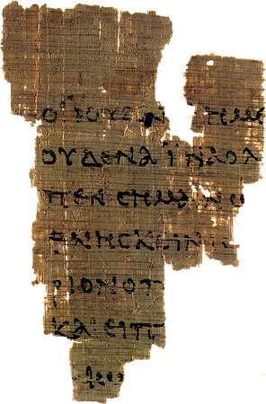
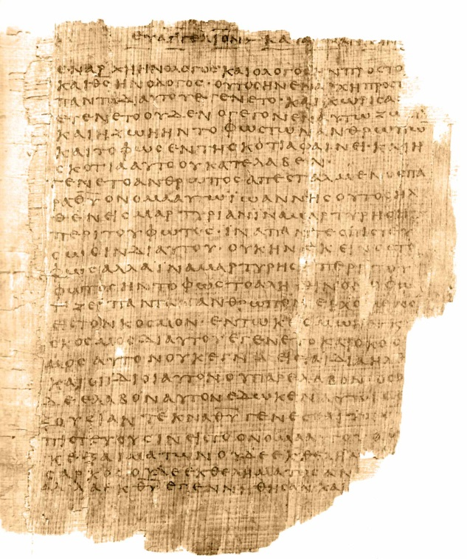
What are our earliest NT manuscripts?
Possibly a couple
from the 1st century
10+ from the 2nd
century P52, P66, P75
40+ from
the 3rd century
The livespan of the manuscripts was 150+ years (Oxyrhynchus)

Slide 69
How many New Testament manuscripts do we have?
Greek – more than 5, 800
Latin – more than 10,000
Coptic, Syriac, Armenian, Georgian, Arabic – all together – more that 10,000
The NT quotes in theological writings – more than 1,000,000

Slide 70
What about the differences in these manuscripts?
400,000+ differences... O, yes! And this on ~ 138,000 words of the New Testament
But there are more than 2.600.000 pages of the New Testament text (1/6 pages)
And - there are several types of differences

Slide 71
What are these differences?
Spelling differences (n) and spelling mistakes (horses)
Little differences – articles, sequence of words, Jesus’ titles
Meaningful, but dubious differences (God vs Christ)
Meaningful and plausible differences (less than 1%) – grammatical tenses
2 passages are difficult – John 7:53-8:11 and Mark 16:9-20

Slide 72
What else can we say about the NT manuscripts?
Most of the manuscripts were copied by professional scribes
‘I feel weird today, don’t know what has happened to me’
‘Thanks God, the end of the book’
Bruce Metzger – I know with confidence that my trust in Christ has been well placed.
Very well placed!

Slide 73
Summary for the Argument # 3
Books were carefully copied by professional scribes
We have manuscripts as old as from the 2nd century AD
There are no significant differences in the manuscripts that would challenge any of our teachings

Slide 74
Summary for the New Testament
We know about the origin of the New Testament
We know about the formation of the New Testament canon
We have so many manuscripts
We know that we have got the right New Testament

Slide 75
Why is the Bible our only source and norm?
Not because of adjectives
Because it is the living God Himself testifying about what He has done and spoken – it is God Himself speaking to us!
And we know a lot about both the origin of the Bible and also about the formation of the canon
We know that our trust is well placed. Very well placed!

