Slide 1
Methods of Biblical Interpretation in Modern Times
Introduction & some helpful images:
  “Digging” as a Metaphor: Seeing the “Ground”
  Triptych as a way to understand approaches to the Bible
Seeing the Ground: The Church
Seeing the Ground: Modern Approaches
  Historical/Biblical Criticism (17th C → present)
  Postmodern Criticisms (latter 20th C → present)
Response & Conclusion
Notes:
Introductory remarks:
Asked to speak on Methods of Biblical Interpretation
Nature of presentation: informational (academic community)
→ major movements in the academy (world)
→ get our bearings.
evaluative (Lutheran confession re. Scripture… Sola Scriptura)
If you are:
“normal”/layperson: new, but it’s fruit isn’t (all around you)… → better understand the mindset/thinking
Theology/Seminary student: …(encounter in reading)… → background/equip: discern (good observations &
Pastor/have studied theology: not much may be “new”

Slide 2
Focus: understanding modern approaches to Biblical study (worldwide)
Why examine it and its history?
Theological reasons
Doctrine of Scripture (everybody uses one)
Self-examination: Practicing what we preach
Missiological reasons
Better understand our world:
  why/how the Bible is viewed as just another religious book
  “unearth” assumptions, prejudices, values that “undermine” a view of Scripture as God’s authoritative Word.
Better engage our world (community, academy)
Notes:
Self-examination:
important spiritual discipline at the core of our Christian lives
ML “Consider your station in life according to the 10 Commandments: are you a father, mother, son, daughter, husband, wife, or worker? etc…”
Practicing what we preach:
allowing the Word of God to have its way with me
light lamp to our feet and light to our path (Ps 119:105)
Doctrine of Scripture: everybody has one
my principle focus
recognize so-called “assured results” (authorship, rejection of biblical history)
but the influences, presuppositions, underlying values → methods/how they see the ground.
my presentation: not final word, but identifying vital questions/issues for the 21st C Church living out its confession of Scripture.

Slide 3
Handling the Word of Truth…
“Bumps in the Text”
  “contradictions”
  “surprises”
Do we assume…
  Harmony?
  Multiple theologies, ideologies?
Notes:
“contradictions”: we’ve all been there

Slide 4

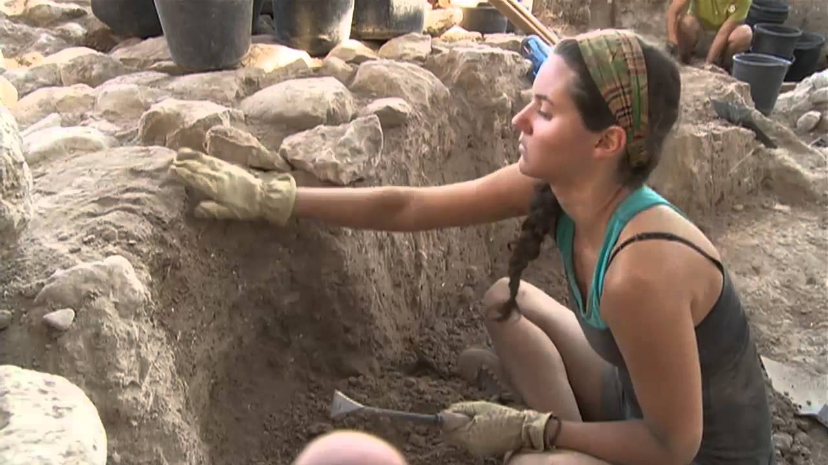
“Digging” as a Metaphor
How does a miner see the ground s/he digs in?
How does an archaeologist see the ground s/he digs in?
  Purpose: ore vs. civilization layers, artifacts
  Implications: excavator vs. trowel & brush open-cut vs. stratigraphy
How does the condition of one’s eyes affect what we see?
Notes:
Different:
“view” of the ground
Purpose/expectations
Method of digging & tools appropriate
We will keep harking back to this “digging” metaphor

Slide 5
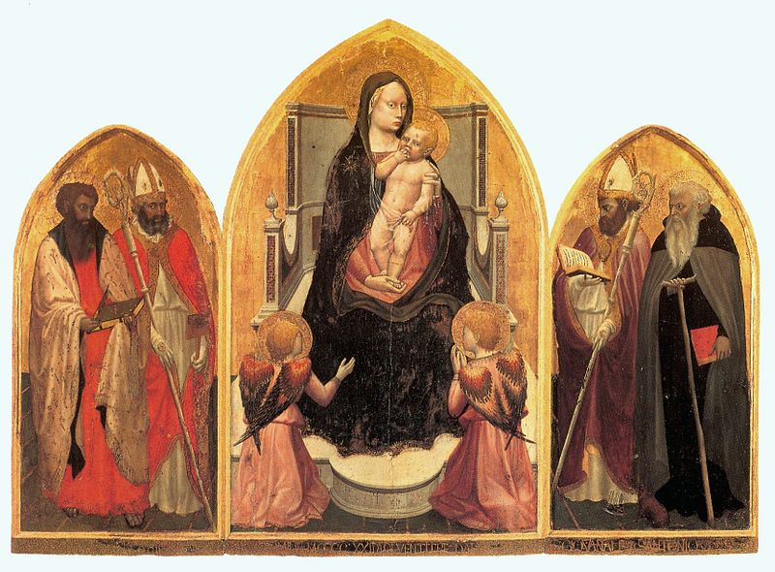
A Triptych
Notes:
Attention focused on the centre panel: Jesus & Mary

Slide 6
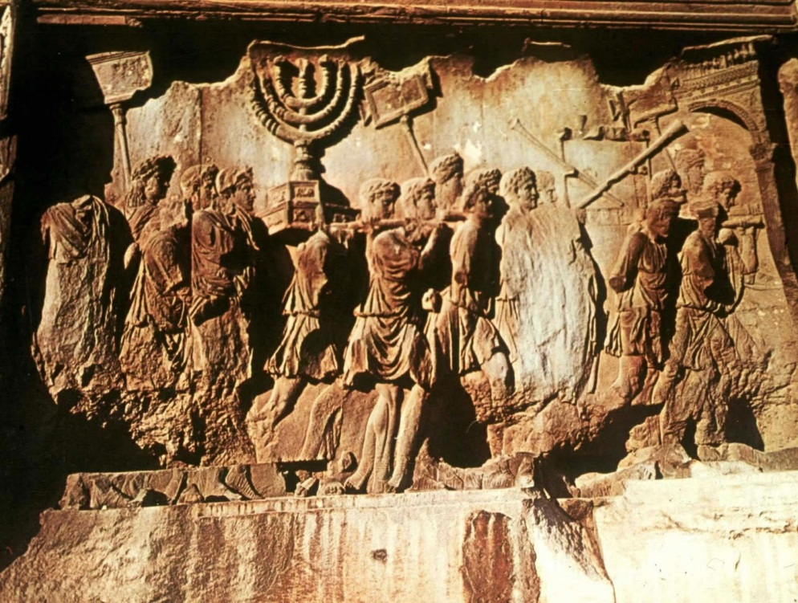
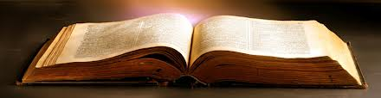
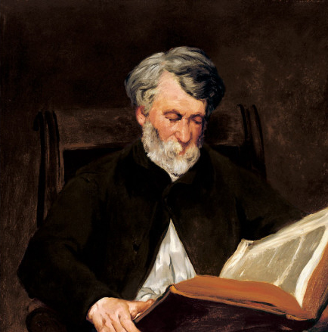
Another “Triptych”
CONTEXT
TEXT
READER
Notes:
CONTEXT
“behind” the text
Human author
Historical circumstances, the “world of the text,” the text (first) addresses
TEXT
Direct window into the “world of the text”
Canonical Word:
READER
“in front of” the text
Reader’s world, ideologies, worldvies

Slide 7
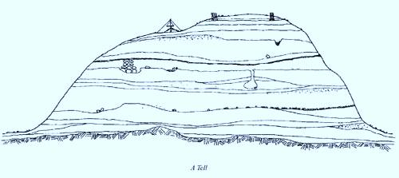

“Digging” into the Word
The Biblical Text = Bedrock, dependable
  Inerrant
  Clear & unified in its witness
Digging through the “mud” & “silt” that “blinds” & “deafens”
  the spirit of our age
  my idols (cf. Ps 115; 135)
Bedrock
Christ the Chief Cornerstone
Prophets & Apostles (Scripture) the foundation
In that day the deaf shall hear the words of a book,
and out of their gloom and darkness the eyes of the blind shall see. (Isa 29:18)
The Spirit of the Lord God is upon me, because the Lord has anointed me to bring good news to the poor; he has sent me to bind up the brokenhearted, to proclaim liberty to the captives, and the opening of the prison to those who are bound… (Isa 61:1; Luke 4:16-21)
Notes:
Dig through to bedrock, not “through it.”
Dig past/through clay/silt/mud (ignorance, prejudices, spirits of our age) → clouds/blinds
Not clear? problem = my fallen nature, not Scripture (Cf. Biblical Criticism)
Holy Scripture remains the only judge, rule, and norm according to which all doctrines should and must be understood and judged as good or evil, right or wrong” (Epitome 1)
= putting sola scriptura into practice
And since this is about modern methods and approaches, the metaphor of digging is most apt.
How, then, shall we now dig?

Slide 8
Seeing the Ground & “Digging” into the Word: the Church
Metaphors have their limits!
  We “hear” the Word (Viva Vox Dei), e.g.,
  “heard”/“proclaimed” (Rom 10:14-16)
  we are passive as God does His work in us (Law & Gospel)
  “God-breathed” (2 Tim 3:16)
  Scripture as “bedrock” (witness of prophets & apostles)
    Church “built on” Christ & His Word (Mt 7:24; 16:16-18)
    Christ the Builder & Cornerstone (Mt 16:18)
    Prophets & Apostles = the foundation (Eph 2:19-21; 1Pet 1:21)
    Material Principle: Christ (John 1:1-14)
    Formal Principle: Scripture as testimony of Prophets & Apostles (Eph 2:20; 1Pet 1:21; Heb 1:1-2)
                …but we still “dig”

Slide 9
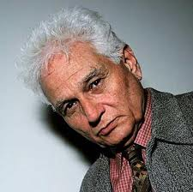
By Contrast, (Post)Modern Views of the Ground…
Culturally: just another “holy” book
“Unstable” (like human language)
  No such thing as a solid foundation
  But you can still “play in the dirt”
  Not reliable historical revelation
  → occasion for present-day social issues
…erosion takes time & it’s been a while since the Enlightenment
17th-21st C: Historical Critical approaches
20th-21st C: Postmodernist, ideologically driven approaches
Notes:
Well known: Postmoderns suffer from a lack of stability
Relativity of truth
Radical human-centredness of “knowing” (epistemology)
“erosion…etc”: major shifts in the academy (~3 centuries)
historically-focused → agnostic/indifferent about “what really happened”
Scientific, “objective” → purposefully & consciously ideological
SAME Interpreter-centric, humanistic posture toward Scripture
Postmodern approaches the “logical conclusion” of historical-criticism
cf. Collins, The Bible after Babel, 25, → David Clines’ ideological criticism
“All of this, it seems to me, can be construed as pushing historical criticism to its logical conclusions, in a way that historical critics have historically failed to do. The skepticism and suspicion that Clines directs towards the Biblical text are analogue of the suspicion of contemporary philosophers towards Enlightenment ideals, or towards any ideals for that matter.”

Slide 10
A Snapshot of the Landscape: Society of Biblical Literature (2014) “sections” according to…
Content:
  “Book of Psalms”
  “Gospel of Luke”
  “Pauline Epistles”
Ideology/Method:
  “African-American Biblical Hermeneutics”
  “Gender, Sexuality, and the Bible”
  “LGBT Queer Hermeneutics”
  “Feminist Hermeneutics of the Bible”
  “Ideological Criticism”
Notes:
A LOT of good work being done…
“MIXED BAG” (discernment needed)
Church not the “lone interpreter” of God’s Word
Pluralistic
Reflects trends of Western Societies
“Babel-like confusion” (John Collins, The Bible after Babel [2005])
Historical Criticism no longer as dominant in high-profile theological faculties
Rise of Postmodern Criticism(s)
John Barton, The Nature of Biblical Criticism (2007)
…but not passe—e.g., “Q” and “Formation of Isaiah” sections at SBL
Postmodern approaches transparent about their ideological commitments
Cf. earlier Historical Critics’ unrealistic aspirations to objectivity, ideological neutrality
Biblical studies → more self-aware of ideology…
Helpful “testing the spirits”
→ need for worldview analysis
→ self-examination concerning “my/our” approaches
does how I interpret Scripture reflect our confession of it?
(metaphor:) digging, tools, & seeing the “ground”

Slide 11
What is “Historical Criticism”?
aka “Higher Criticism” (vis-à-vis “lower” or “textual” criticism)
Collection of diverse methods (evolved over 18th-20th Cs)
So-called “assured results”:
  Authorship (Pentateuch; Gospels; Pastoral Epistles); history
“Historical”
  (laudably) interested in historical context
  (regrettably) deconstructs biblical texts
  reconstructs history & “second-guesses” biblical chronology/events (modern historian’s “better” judgment)
  (historical context of the interpreter?)
“Critical”
    critical thinking an indispensable tool (→ human argument)
    Reason as “master” of Scripture, not “servant”
Notes:
Not monolithic
Assured results (discuss an e.g. later):
views more or less accepted in some form
despite actual variety/contrary evidence
“historical”:
understanding texts in historical context = good practice
deconstruction: sources & their origins as “real” context
low view of biblical chronology (minimalists etc.);
evolution of biblical text via different “stages” of development
“Critical”;
important
may be misshapen/misapplied
early critics’ over-confident “objectivity” (& corresponding lack of self-examination/criticism)
later (postmodern) critics’ resignation concerning the possibility of any kind of certainty

Slide 12
Some Characteristics of Historical Criticism and its History
Richard Simon (17th C)
  “Father of Higher Criticism”
  Catholic Priest; discredit Sola Scriptura
Baruch Spinoza (18th C), Johann Semler (19th C), etc.
  “like any other literature”
  Bible contains the Word of God, not is the Word
Intrusion of (non-Biblical) worldviews under the guise of “objective” scientific scholarship
    E.g. Julius Wellhausen’s & the “Father of Sociology” Auguste Comte’s evolving view of religion (“primitive” → “sophisticated”)
    Making room for humanistic agendas; reading “against the grain”
Notes:
Richard Simon: sources for the Pentateuch
“Like any other literature”
½ true: 100% human 100% Divine
(modern HCs): taking the humanity of Scripture “seriously”
but methods don’t take the Divinity of Scripture seriously
skepticism, not confidence/appreciation
rejection of miracles
rejection of prophecy
contains/is
understanding texts in historical context = good practice
deconstruction: sources & their origins as “real” context
low view of biblical chronology (minimalists etc.);
evolution of biblical text via different “stages” of development

Slide 13
The “Triptych”
Historical Criticism: eyes on CONTEXT Redefine context, & text
CONTEXT
Spinoza (17th C), Semler (18th C), etc.: “any other literature”
Text: product of religious evolution (History of Religions School)
Text: product of human cultural milieu (social sciences)
TEXT
READER
Notes:
CONTEXT
“behind” the text
Human author
Historical circumstances, the “world of the text,” the text (first) addresses
Sensible and very valuable (to a degree):
Bible: human language and in real historical contexts
Biblical writers: common Ancient Near East imagery, poetic or proverbial material, etc.
But in practice:
HCs → own rationality the judge and norm of what was truthful or false
“view of the ground” → Bible contains the Word of God, not that the Bible is Word of God
Little room for divine revelation or the supernatural (Kant)
Prophecies “after the fact” (post eventu)
Miracles = suspect or ruled out altogether
(effect on HC evaluations of context = profound)
Forms judgments based on limited human perspectives (e.g., Isaiah)

Slide 14
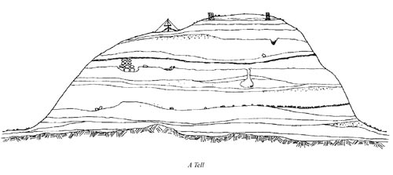
“Assured Result” e.g. 1: Pentateuch (Gen-Deut)
How have Historical Critics “seen the ground”?
Source Criticism
R. Simon (17th C)
Jean Astruc (18th C)
J. Wellhausen (19th C)
Form Criticism
H. Gunkel (post-WWI)
(Gospels: R. Bultmann [post-WWI])
(Tradition Criticism
G. von Rad [post WWII])
Redaction Criticism
(post WWII)
Canonical Criticism
B. Childs (later 20th C)
Priestly (P)
Deuteronomist (D)
Elohist (E)
Yahwist (J)
Oral traditions
Oral traditions
Oral traditions
→ narrative approaches (seeing the mound again)
Notes:
Example 1: Pentateuch (because…)
where higher/historical criticism started (17th-19th Cs)
see emergence of “new” criticisms/approaches & historical context of interpreters
see the flux & change in scholarly opinion
illustrates general approach to historical critical biblical study (prophets, gospels, etc.)
How they “see the ground”
like a tell
multilayered traditions (numerous scribal hands over centuries)
need to “excavate” (R. Alter)
Source Criticism:
Richard Simon:
“Father of Higher Criticism”
Roman Catholic priest: → undermine sola scriptura (sources, not Moses)
Astruc: 4 sources → “Old Documentary Hypothesis”
Wellhausen:
“New” Documentary Hypothesis
chronological sequence (Wellhausen)
J: mid 9th C (henotheism)
E: mid 8th C
D: late 6th C (monotheism; Josiah’s reforms)
P: 1st ½ of 5th CJ/E distinction questioned
→ religious evolution (history of religions school/Comte & sociology of religion)
NOT value-neutral, “objective”
Their “bedrock” = literary sources (J, E, D, & P)
Implications:
“redactors” = crude assemblers/“scissors & tape-men”
atomistic, not holistic reading
No Moses/Mosaic-mediation of Torah
Deconstruct & reconstruct history (& theology with it!)
variations:
Old Documentary Hypothesis: PJED
recent thought: P before D? (Richard Friedman: JEPD)
J/E distinction?
Form Criticism:
Gunkel: “Father of Form Criticism”
WWI & theological bankrupsy of source criticism (cf. rise of spiritism)
→ older, “living traditions”
again, history reassembled from floating bits of “tradition” (e.g., historical Jesus)
Tradition Criticism:
Gerhard von Rad: retrieving a unified Biblical Theology amid the disunited, pluralistic voices unearthed by source-criticism
Redaction Criticism:
redactors = creative theologians in their own right (contra. Source critics)
assumes source/form criticism: study how the redactors “used their sources” → window into their world
Implications, e.g., for Gospels: Gospel of Jesus Christ or Gospel/theology of assumed “Matthean,” “Johannine” communities etc.
Barton’s disappearing redactor
author? (but not Moses!)
→ postmodern approaches’ interest in the whole text
Canonical Criticism:
seeing the whole mound (again) → holistic reading (a good thing!)
(typicaly assumes complex pre-history)

Slide 15
“Assured Result” e.g. 2: Pastorals (1-2 Tim, Titus)
Why critical scholars think Paul did not write them?
Differences in vocabulary vs. “genuine” letters of Paul
“later” (2nd C) church organization (religious/theological evolution)
David Meade: → how the theory might fit the Pastoral Epistles
          (i.e., not “proven”)
            Fabricated names, circumstances (e.g., 2Tim 4:9f) → air of authenticity & therefore authority
            Objections:
  If a hat fits, it does not follow that it’s mine… & that’s a very big IF, because:
  Creates more problems that it solves
  Evolution of doctrinal/ecclesiastical “development” = speculative
  Absence of 2nd C issues like martyrdom & state’s attitude to Christianity
  Language vis-à-vis audience & occasion
    What do James Bond and Chitty Chitty Bang Bang have in common?
Notes:
Example 2: Did Paul write the Pastoral Epistles?

Slide 16
Summing Up The Character of Historical Criticism & Some Implications…
Atomistic: assumes contradiction, not harmony
  Theologies of the Bible, not theology
Deconstructive: skeptical of the Bible’s own testimony to theological history (Christ!)
Reconstructive: revisionist “history of religion/doctrine”
“humanity” of Scripture or a “humanistic” view of it?
  Like “any other literature” (18th C: Spinoza; 19th C: Semler)
  Product of a long history of redaction (editing) of sources
  Product of religious evolution (Auguste Comte; History of Religions)
  A practical denial of Divine revelation (e.g., Moses as mediator of Covenant/Torah = literary device, not historical reality)
Notes:
Atomistic:
Theologies, not theology: “Unity & Perspicuity” of Scripture?
Deconstructive:
Historical religion: If Christ has not been raised from the dead… (but just in the “proclamation” of the church…)
Humanization:
Product of redaction…etc.: Prophets & Evangelists? (& Paul [pseudepigraphy]?)
Product of religious evolution…etc.: religion/religious consciousness as a socio-religious phenomenon
Rise of modern sociology (we’ll take this up later)
practical denial of Divine revelation…etc: severing the Divine & Human natures of Scripture? (we’ll take this up later [Sparks])

Slide 17
A Surprising Thing? The Incursion of Historical Criticism in American Evangelicalism
American Evangelicalism:
a traditionally high view of Scripture
Instructive for us: how do critical Evangelical scholars persuade their fellow Evangelicals to embrace HC?
e.g., Kenton Sparks, God’s Word in Human Words
“believing criticism”
“assured results” compel self-respecting scholars to accept historical criticism
we know stuff “adequately” through language (“practical realism”)
Legacy of Reformers (= Humanists)
Analogy of Christ’s Divine & Human natures:
  “God’s Inerrant Word in errant human words”

Slide 18
From Sparks…
“interpret adequately”
Humanists:
  “back to the sources”
  Erasmus: our reason = adequate to interpret (freedom of the will)
  Luther: problem not that we’re finite but fallen (bondage of the will)
“Our mediated interpretations”
Does not distinguish:
  Interpreter: fallible, fallen
  Medium (Scripture): not
    (Finite is capable of the Infinite)
“there is nothing unseemly or tragic about the limited perceptual horizon that God has granted to human beings. Our finite capacities are good aspects of God’s created order, in both its original (prelapsarian) and subsequent (postlapsarian) permutations. We are doubly blessed by these finite capacities, for they allow us not only to interpret adequately but also to notice and appreciate the profound difference between the divine and human viewpoints. Our mediated interpretations of reality contrast sharply with our Creator’s immediate knowledge of things…” (54)
“Is it therefore possible that God has selected to speak to human beings through adequate rather than inerrant words? …When all is said and done, I will strongly support a doctrine of inerrancy when it comes to Scripture.” (55)
Notes:
16th C Humanism:
Sparks = a good Erasmian (can’t expect him to be Lutheran)
“finite is capable of the infinite”
Can the fullness of God be united to the flesh of the man Jesus of Nazareth? YES, finitum capax infiniti
Can Christ’s resurrected Person—Divine & Human—be bodily, locally present in the bread & wine of the Lord’s Supper? YES, finitum capax infiniti
Can Human words BE Divine Words? YES, finitum capax infiniti
(contrast: Inerrant Divine Word in (errant) human words)
On (in)errancy:
He draws his main conclusion by asking, “Is it therefore possible that God has selected to speak to human beings through adequate rather than inerrant words…?” Clearly, this does not comport well with our confession of Scripture. Without explaining how, Sparks soon goes on to claim that “[w]hen all is said and done, I will strongly support a doctrine of inerrancy when it comes to Scripture.” What does this mean in view of Sparks’ willingness to accept an errant Bible? Rather than explain that apparent contradiction Sparks goes on the offensive, shifting the focus to “our human interpretations of Scripture” that Evangelicals are guilty of turning “into infallible “verbal idols.”” We would surely agree with the fallibility of human interpretations, but that is a distinct issue from the question of Biblical inerrancy. Indeed, Sparks makes no meaningful distinction between fallible interpreter and Biblical text. ^{DSTO VIII, 10}.

Slide 19
Postmodern Criticisms: Seeing Unstable Ground
Many and various “criticisms”:
  Post-Colonial
  Feminist
  Gender
  Deconstructive, etc.
Seeing the ground:
  Text as a whole (“final form,” not sources)
    disinterested in historical questions (contra HC)
  Text as ideological battleground (in their sights: “male dominated,” “Pro-Western” academy & its “agenda”)
  Text as human word/ideology (“winners write the history”)
  Purposefully viewing the Text through an ideological lens

Slide 20
The “Triptych”: eyes on READER
Combatting “oppressive” interpretations
Text: doesn’t exist except in Readers’ experience/use of it
  HC Interpreters’ (mis)use of Texts to justify “oppressive status quo”
  Postmodern Critics’ ideological framework supplants the theological agenda of the BiblicalText (e.g., “sin-grace;” Law-Gospel)
CONTEXT
TEXT
READER

Slide 21
Example 3: Post-Colonial Criticism
Postcolonial critic’s “lens”: The West versus the “Rest”
Bible: among the “Western ‘documents’ of power”
“Postcolonialism is a critical theory that tries…to critique knowledge acquired and influenced by…[racism, the superiority of the West over the Other]…and to retrieve and construct the knowledge of the Other that has been distorted, neglected, or suppressed in the West.” (Kim, 164)
Book of Judges: e.g., 2:11-15
  Postcolonial take:
    The “Other” = The Canaanites, construed as “enemy”
    Text: “to justify the conquest and ownership of the land” (Kim, 175)
    Text: human, political word
    Western Interpreters: to justify West’s conquest of the Rest
  Ideology of the Reader vs. Theology of the Text
    Us: idols; seeking what is “right in our own eyes”; repentance
    God: judges the living & the dead; faithful to covenant promises
Notes:
Skepticism:
Israelites control the narrative
“the origin of violence against others [is] in the very act of representing the Other”
Book of Judges:
Cycle of Israelites’
Israel’s idolatry/apostasy: always turning from Yahweh to worship the Baals
Divine judgment: God sends other nations/plunderers
Divine deliverance: God sends “Judges” to save Israel

Slide 22
Postmodern Approaches: disgruntled “children” of Historical Criticism:
John Collins, on David Clines’ ideological criticism:
“All of this, it seems to me, can be construed as pushing historical criticism to its logical conclusions, in a way that historical critics have historically failed to do. The skepticism and suspicion that Clines directs towards the Biblical text are analogue of the suspicion of contemporary philosophers towards Enlightenment ideals, or towards any ideals for that matter.” (Collins, The Bible after Babel, 25)
Radical Skepticism (vs. radical appreciation)
Practicing a belief in the (corrupt) humanity of Scripture (vs. Divine and Human natures of Scripture held together)

Slide 23
Who “deconstructs” whom?
Historical Critic seeks to deconstruct the Biblical Text
Postmodern Critic seeks to deconstruct:
  Ideology of the Text
  Ideology of the Interpreter & status quo
Scripture:
Law: “deconstructs” us/idols → KILLS
Gospel: “reconstructs” us → MAKES ALIVE

Slide 24
A Few Brief Reflections on “Mining” Historical Critical and Postmodern Work for “gems”…
Focus on “final form” of Biblical Books → helpful
  (despite some questionable assumptions along the way)
  Canonical Approaches
  Narrative Approaches
  Form criticism for, e.g., individual psalms
Work of Postmodern (& Historical Critical) scholars:
  Often make good observations
  Rationalistic or ideological agendas/worldviews
Notes:
Canonical Criticism: focus on Books as theological wholes.
Narrative Criticism:
→ many insights
E.g., Jeff Gibbs’ story of a Jewish, Feminist narrative critic & the Gospel of Matthew
Form Criticism:
often been used to dissect Biblical texts
Applied discerningly it can serve well
TEXT-CENTRIC APPROACHES (NOT READER/CONTEXT)

Slide 25
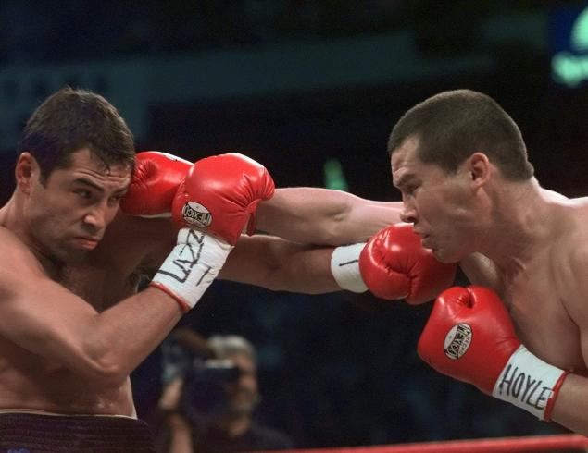

Old, Fight-Hardened Contender vs.
The New Kid(s) in the Ring
HC
PM

Slide 26
An Opportunity…
To the Historical Critic:
“Thank you for pointing out all sorts of interesting features in the Biblical text. But listen to the voice of Another, The Holy Spirit, which you mistake for a mere phenomenon of human religiosity.”
To the Postmodernist:
“Thank you for keeping us aware of the “other” in the text. But Listen to the voice of Another, The Holy Spirit, which you would reduce to a mere perspective amid a sea of relativity.”

Slide 27
An Opportunity to see how modern approaches:
Offer a smorgasbord of interpretive options
Often very speculative
Often parrot the philosophical values and ideologies du jour
Proceed from faith too, e.g.:
  faith in the evolution of religion/theology
  faith in a different story of Israel’s history
  faith in a Gnostic Jesus who married and had kids
  faith in my own objectivity and critical judgment
  faith in the philosophical or social winds that blow in our current day
Not faith or reason, but faith and reason
in proper relationship (& with faith’s proper object)

Slide 28
But most of all, an Opportunity to…
See the ground as Christ shows it
Practice what we preach
Repent of our idols, resist temptation, & self-examine
Bedrock
Christ the Chief Cornerstone
Prophets & Apostles (Scripture) the foundation

