Slide 1
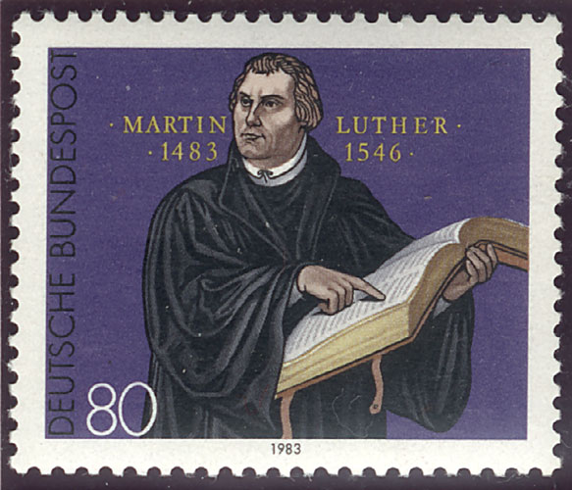

Slide 2
Here we ask why Christ did not lead these magi up to Bethlehem with the star, but instead permitted his birth, which was now known, to be searched for in Scripture. He did this to teach us to cling to Scripture and not to follow our own presumptuous ideas or any human teaching. For it was not his desire to give us his Scripture in vain. It is in Scripture and nowhere else, that he permits himself to be found. He who despises Scripture and sets it aside, will never find him. (Christmas Postil [1521], LW 52:171)

Slide 3

Wise builder: built his house on the rock of God’s Word

Slide 4


Slide 5
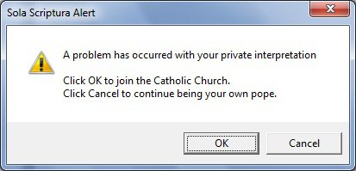

Slide 6
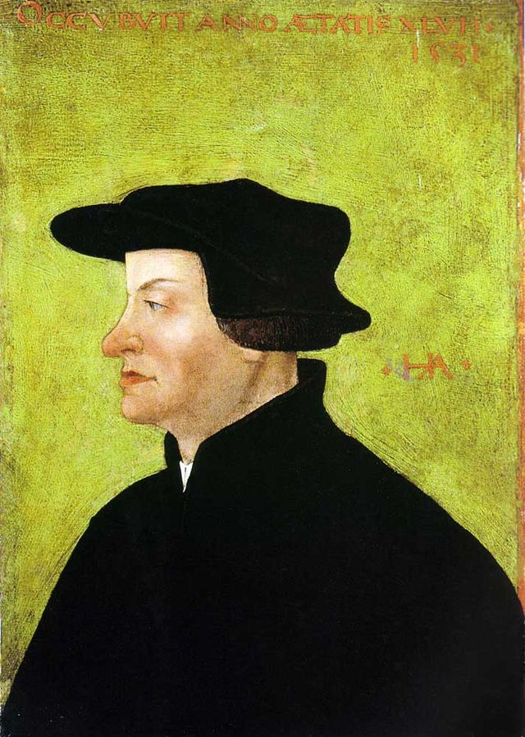
Zwingli:
That’s not reasonable

Slide 7

Scripture interprets Scripture

Slide 8
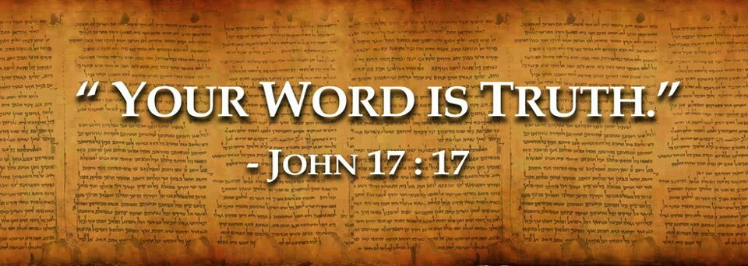

Slide 9
Implications:
Believe it

Slide 10
Implications:
Believe it
Submit to it

Slide 11
Implications:
Believe it
Submit to it
Read each part in the context of what we know to be true

Slide 12

The Gospel of Jesus Christ is the key to making sense of Scripture as a whole

Slide 13
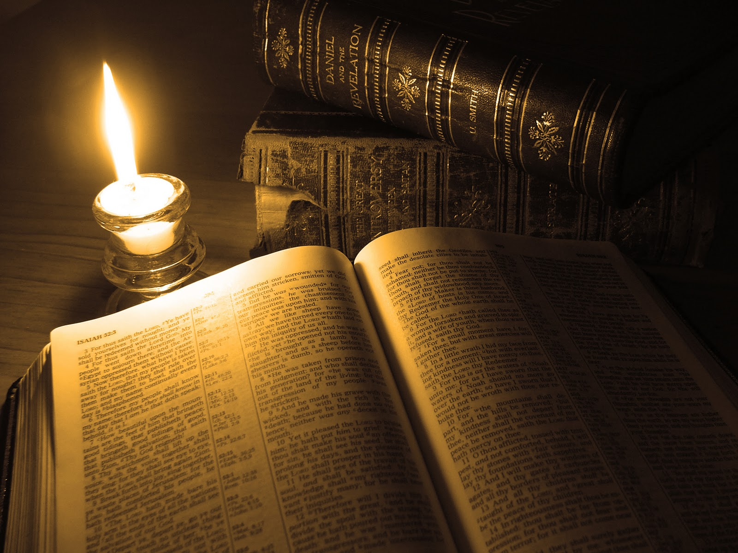
Scripture is clear

Slide 14
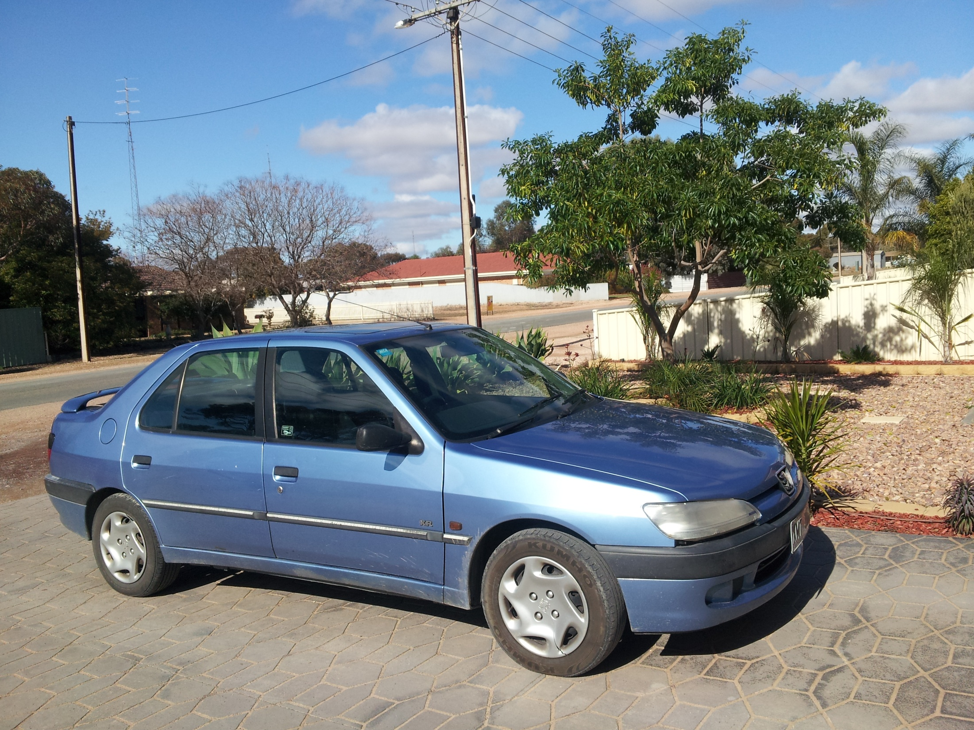

Slide 15
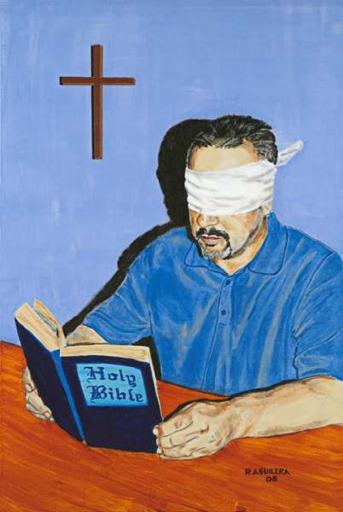

Spiritual Laziness
Spiritual Blindness

Slide 16
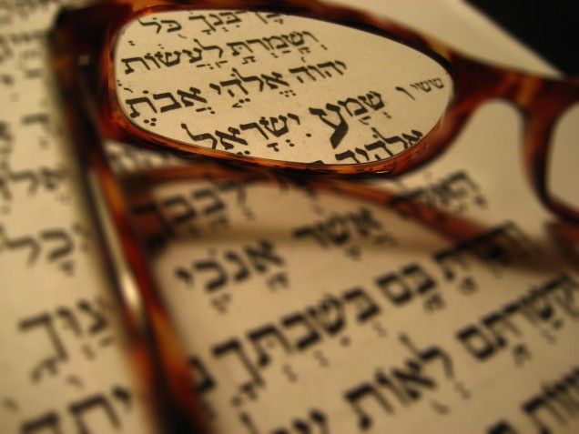

Slide 17
Evasions:

Slide 18
Evasions:
Laziness

Slide 19
Evasions:
Laziness
Preferencing human interpretations and opinions

Slide 20
Evasions:
Laziness
Preferencing human interpretations and opinions
Claiming direct illumination from the Spirit

Slide 21
Evasions:
Laziness
Preferencing human interpretations and opinions
Claiming direct illumination from the Spirit
Importing thoughts and definitions from philosophy

Slide 22
Evasions:
Laziness
Preferencing human interpretations and opinions
Claiming direct illumination from the Spirit
Importing thoughts and definitions from philosophy
Obscuring words by ignoring grammar and context, or by reading selectively

Slide 23
Evasions:
Laziness
Preferencing human interpretations and opinions
Claiming direct illumination from the Spirit
Importing thoughts and definitions from philosophy
Obscuring words by ignoring grammar and context, or by reading selectively
Evading the natural meaning of the words

Slide 24
X

Slide 25
“No prophecy ever came by the impulse of man; but moved by the Holy Spirit, holy men of God spoke.” [2 Pet 1:21] Therefore we sing in the article of the Creed concerning the Holy Spirit: “Who spake by the prophets.” Thus we attribute to the Holy Spirit all of Holy Scripture and the external Word and the sacraments. (Treatise on the Last Words of David [1543], LW 15:275)

Slide 26
Holy Scripture is God’s Word, written and spelled and formed in letters, just as Christ is the eternal Word of God veiled in human flesh. (Sprüche aus dem Alten Testament [1541], WA 48:31.4–6)

Slide 27
Holy Scripture is God’s Word, written and spelled and formed in letters, just as Christ is the eternal Word of God veiled in human flesh. (Sprüche aus dem Alten Testament [1541], WA 48:31.4–6)
The saints could err in their writings and sin in their lives, but the Scriptures cannot err. (Misuse of the Mass [1521], LW 36:137)

Slide 28
Natural reason creates heresy and error, while faith teaches the truth and clings to it; for it clings to Scripture, which neither deceives nor lies. (Christmas Postil [1522], LW 52:49)

Slide 29
Natural reason creates heresy and error, while faith teaches the truth and clings to it; for it clings to Scripture, which neither deceives nor lies. (Christmas Postil [1522], LW 52:49)
We dare not give preference to the authority of men over that of Scripture! Human beings can err, but the Word of God is the very wisdom of God and the absolutely infallible truth. (Lectures on Genesis [1535-36], LW 1:122)

Slide 30
The Word is so irreproachable that not a single iota can err in the Law or the divine promises. For that reason we must yield to no sect, not even in one tittle of Scripture, no matter how much they clamor and accuse us of violating love when we hold so strictly to the Word. (Lectures on Psalm 45 [1532], LW 12:242)

Slide 31
The Word is so irreproachable that not a single iota can err in the Law or the divine promises. For that reason we must yield to no sect, not even in one tittle of Scripture, no matter how much they clamor and accuse us of violating love when we hold so strictly to the Word. (Lectures on Psalm 45 [1532], LW 12:242)
My neighbor and I—in short, all men—may err and deceive, but God’s Word cannot err. (Large Catechism IV, 57 [Tappert, p. 444])

Slide 32
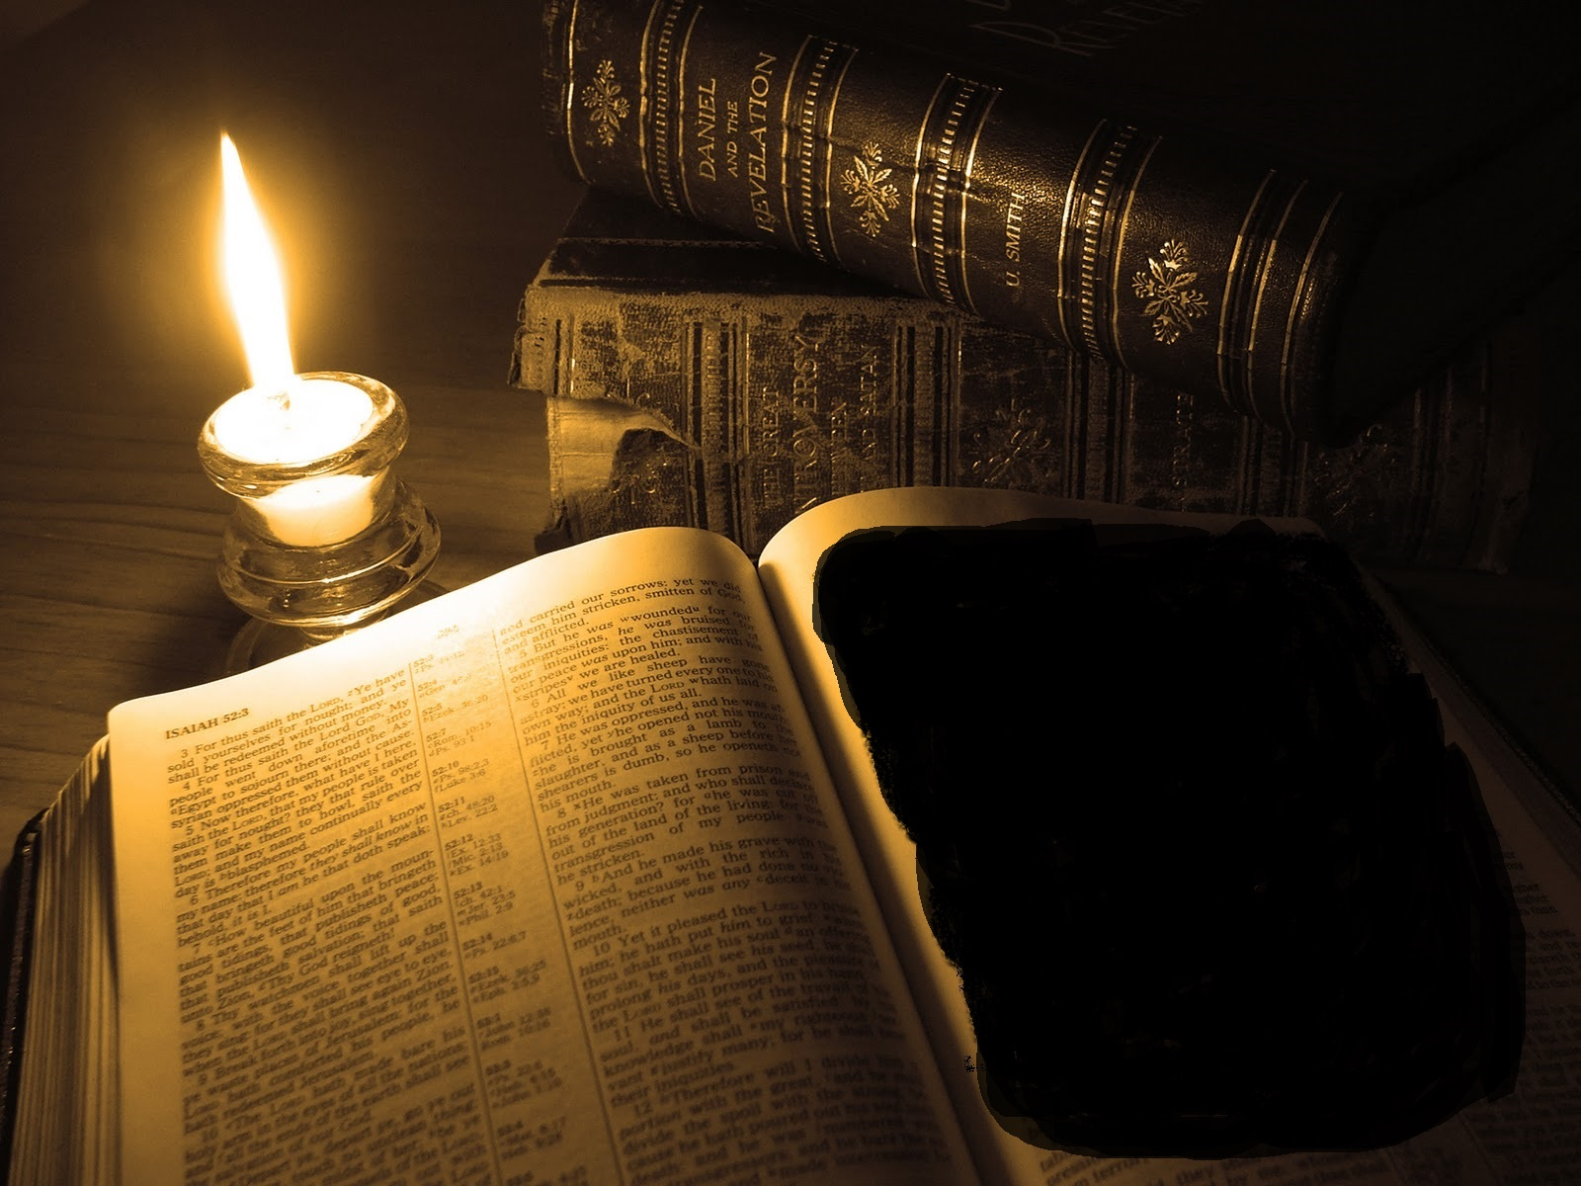
Partly Light and Partly Dark?

Slide 33
But here you will say, “All this is nothing to me; I do not say that the Scriptures are obscure in all parts (for who would be so crazy?), but only in this and similar parts.” I reply: neither do I say these things in opposition to you only, but in opposition to all who think as you do; moreover, in opposition to you I say with respect to the whole Scripture, I will not have any part of it called obscure. What we have cited from Peter holds good here, that the Word of God

Slide 34
is for us “a lamp shining in a dark place” [II Peter 1:19]. But if part of this lamp does not shine, it will be a part of the dark place rather than of the lamp itself. Christ has not so enlightened us as deliberately to leave some part of his Word obscure while commanding us to give heed to it, for he commands us in vain to give heed if it does not give light. (Bondage of the Will [1525], LW 33:94-95)

