Slide 1

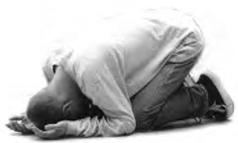
Luther and the idolatry of human reason

Slide 2


Spiritual Laziness
Spiritual Blindness

Slide 3
Reason as an idol

Slide 4

Reason as an idol

Slide 5

X
Reason as an idol

Slide 6
X
Distinctions: 1. Above and below

Slide 7
X
Distinctions: 1. Above and below
2. Servant vs. master

Slide 8
X
Let us show the Holy Spirit the honor of conceding that He is smarter and wiser than we are with our infantile knowledge (Sermons on John [1537], LW 24:109–10)

Slide 9
X
Reason: Anything that is considered wise by human beings that has not been established by God’s word

Slide 10
X
The Anabaptists, the Sacramentarians, and the papists are all idolaters—not because they worship stones and pieces of wood, but because they give up the Word and worship their own thoughts. (Lectures on Genesis [1535–38], LW 1:149)

Slide 11


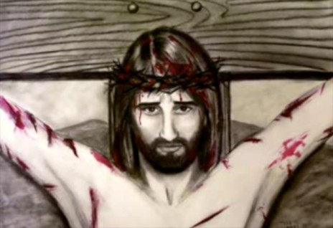




Will we allow the Holy Spirit to be our teacher?

Slide 12
Will we allow the Holy Spirit to be our teacher?
X
X
Thus God, the Lord of all the world, must let Himself become all the world’s pupil. No sermon, no proclamation in the world, has ever found as many critics as the Word of God. Every fool makes bold to tangle with it and tries to win his spurs in the encounter. There is no one who does not think he can correct God’s Word, who does not feel it

Slide 13
Will we allow the Holy Spirit to be our teacher?
X
X
incumbent upon him to oppose it, who does not presume to be smarter than our Lord God. Nowadays when anyone dreams a little, he is quick to cry: “Spirit! Spirit!” There is none so lowly as not to claim to know it all. Everyone poses as God’s teacher, and He must be everybody’s pupil. (Sermons on John [1530–32], LW 23:208–9)

Slide 14
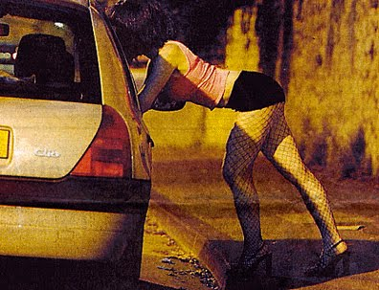
Reason:
The Devil’s Whore

Slide 15
Reason:
The Devil’s Whore
Just as a virgin is physically pure and blameless, so the soul is spiritually blameless because of faith, through which it becomes the bride of Christ. But if it falls from faith into false doctrine, it must go to ruin. For this reason Scripture

Slide 16
Reason:
The Devil’s Whore
consistently calls idolatry and unbelief adultery and whoring, that is, if the soul clings to the teachings of men and thus surrenders faith and Christ. (Sermons on First Peter [1522], LW 30:26 = WA 12:282.19–24)

Slide 17
Reason:
The Devil’s Whore
Just as a person does not use the evil of passion well unless he is a married man, so no person philosophizes well unless he is a fool, that is, a Christian. (Heidelberg Disputation [1518], LW 31:41 = WA 1:355.4–5)

Slide 18

Human reason as the source of idolatry

Slide 19
We cannot know the true God by means of our own natural wisdom because:
Human reason is limited

Slide 20

Natural human reason does not know the Gospel

Slide 21
We cannot know the true God by means of our own natural wisdom because:
Human reason is limited
Human reason is distorted by the sinful human will

Slide 22

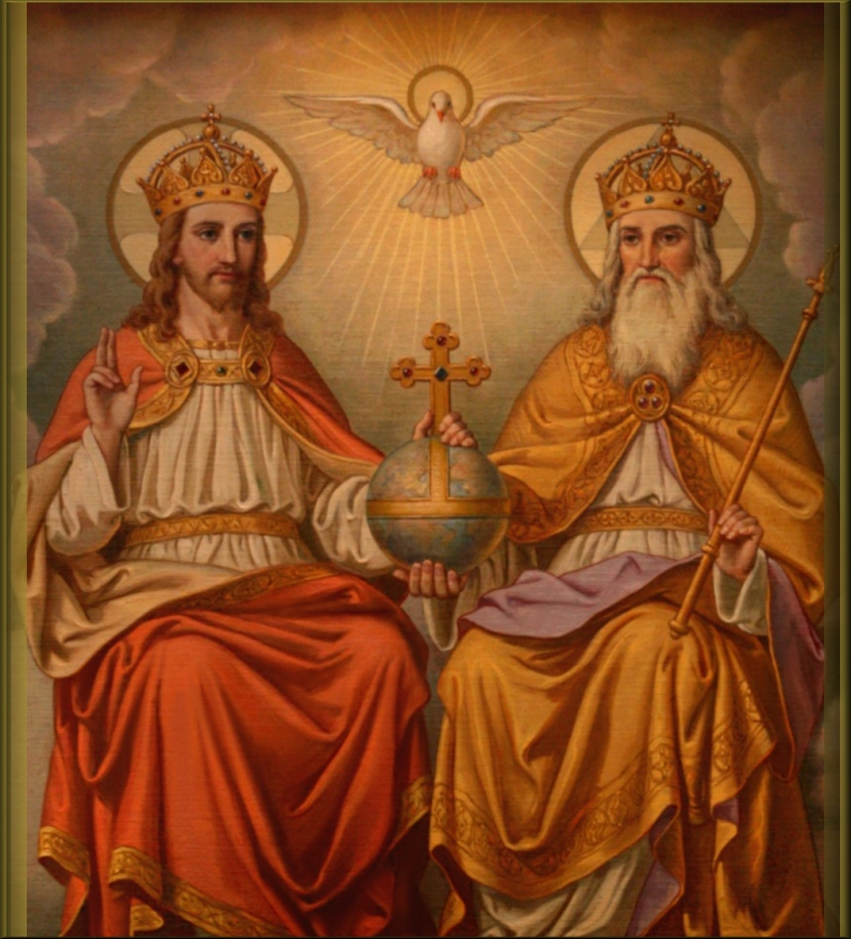


Slide 23


Slide 24

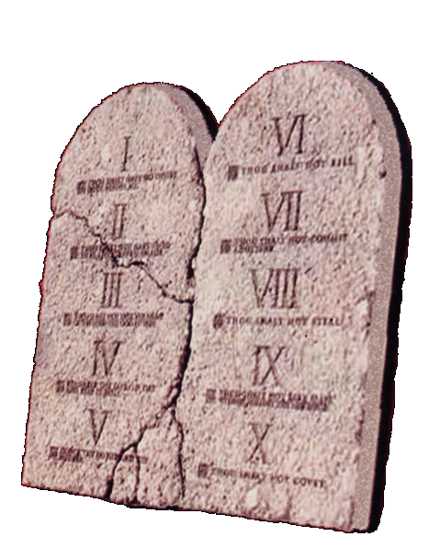

Slide 25
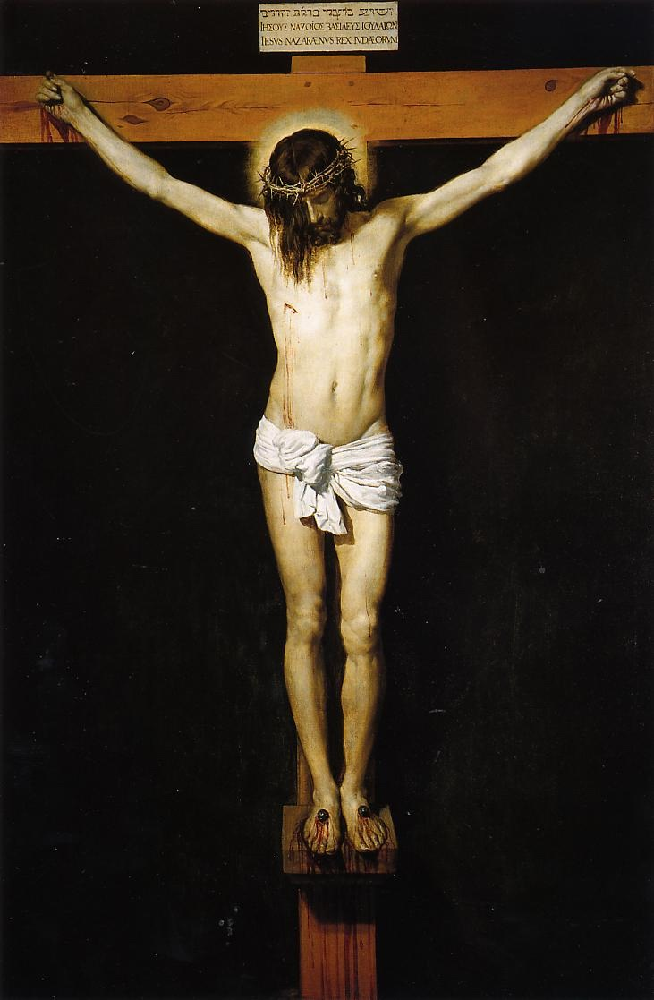
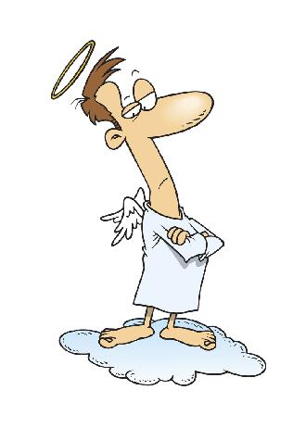
X

Slide 26
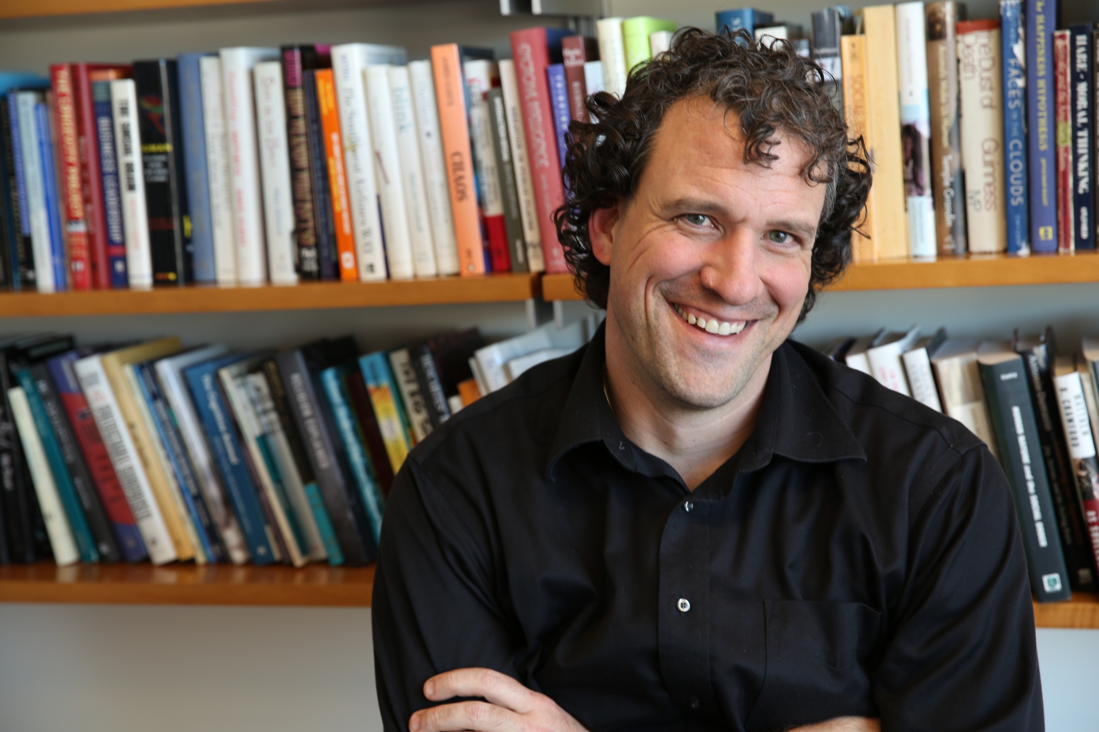
Nicholas Epley – We really do make God in our own image

Slide 27


Slide 28

Higher Biblical Criticism

Slide 29

Prayer

Slide 30
Prayer
Word

Slide 31
Prayer
Word
Christ

Slide 32
Prayer
Word
Christ
Faith

